Slide 1
Economy Slowing, the Fed Slows, Housing Plateaus
Doug Duncan
Chief Economist
Fannie Mae
March 19, 2019

Slide 2
Disclaimer
Opinions, analyses, estimates, forecasts, and other views of Fannie Mae's Economic & Strategic Research (ESR) group included in these materials should not be construed as indicating Fannie Mae's business prospects or expected results, are based on a number of assumptions, and are subject to change without notice. How this information affects Fannie Mae will depend on many factors. Although the ESR group bases its opinions, analyses, estimates, forecasts, and other views on information it considers reliable, it does not guarantee that the information provided in these materials is accurate, current, or suitable for any particular purpose. Changes in the assumptions or the information underlying these views could produce materially different results. The analyses, opinions, estimates, forecasts, and other views published by the ESR group represent the views of that group as of the date indicated and do not necessarily represent the views of Fannie Mae or its management.

Slide 3
Macroeconomic Overview

Slide 4
Current Expansion is Long but Comparatively Weak
1 = Level at Recession Trough
Will be passed by the current expansion in August 2019
Projection

Slide 5
Unemployment Rate Near 50-Year Low but Slower Job Growth This Cycle

Slide 6
Not All Regions of the Country Have Recovered at the Same Pace

Slide 7
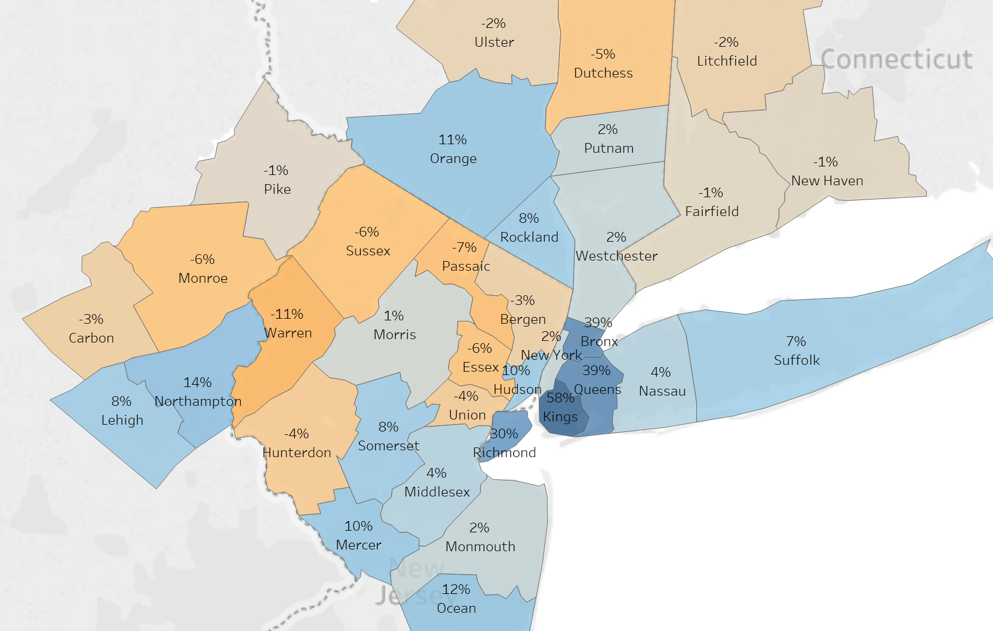
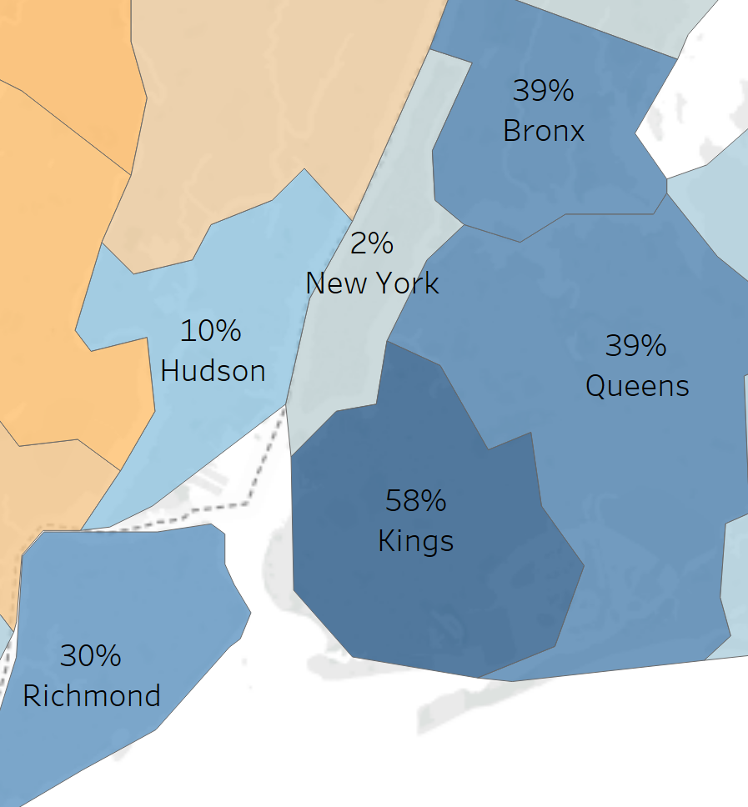
Geographic Distribution of Job Growth
Change in Net Employment By County for NYC Metro Area From Pre-Recession Peak Through Q2 2018
US: 8.6%
* Based on location of employment establishment

Slide 8
Job Growth in Florida Has Outpaced the National Average

Slide 9
Wage Growth Has Picked Up But Inflation Still Lags
Y/Y % Change in Hourly Wages and PCE Inflation

Slide 10
Consumer Confidence Measure of Income Growth Expectations Pulls Back but Remains Near Cycle High

Slide 11
Auto Sales Have Likely Peaked

Slide 12
Consumer Attitudes on Purchasing Big Ticket Items Remains Positive
Source: University of Michigan

Slide 13
Non-Financial Corporate Sector Highly Leveraged by Historical Standards

Slide 14
Stock Market Volatility Reemerges as a Risk to Continued Expansion
Dec-18: Jobs Report Shows 250K jobs added and 3.1% annual wage growth
Jul-18: US Introduces First Phase of Tariffs on Chinese Goods
Oct-18: Chinese Stocks Decline
Dec-17: Tax Bill Passes
Feb-18: Increased inflation expectations and higher rates leads to worst stock decline in 2 years
Nov-18: Oil Prices Decline on Global Growth Worries
Apr-18: 10-Year Breaches 3% for first time since 2014
Dec-18: Government Shutdown Begins

Slide 15
Government Spending Contribution to Growth Slowing
Notes: Includes both direct spending and transfer payments, state and local spending for ’17 and ‘18 are estimates.

Slide 16
Interest Rates and Fed Policy

Slide 17
Interest Rates Projected to Remain Steady
Forecast

Slide 18
Aggregate Major Global Central Bank Balance Sheets Shrinking
*G4 includes Federal Reserve, European Central Bank, Bank of Japan, and Bank of England

Slide 19
Ten-Year Treasury Yield Higher Than Most Industrial Nations’ Equivalent
Ten-Year Bond Yields of Major Industrialized Nations (Quarterly Average, %)
Ten-Year Bond Yields as of 3-14-18
Australia | 2.24%
Canada | 1.75%
France | 0.47%
Germany | 0.08%
Japan | -0.05%
Switzerland | -0.36%
United Kingdom | 1.22%
United States | 2.63%

Slide 20
Headline Inflation Decelerates as Core Inflation Remains Steady

Slide 21
Acceleration in US Debt Issuance Will Coincide with Negative Net Fed Treasuries Purchases
Annual Net US Government Debt Issuance and Net Fed Treasury Purchases ($Billions)
CBO Projection / Fed Balance Sheet Reduction Schedule

Slide 22
Macroeconomic Forecast
 | 2017 | 2018 | 2019 | 2020
Real GDP Annual Growth (Q4-over-Q4) | 2.5% | 3.1% | 2.2% | 1.6%
Unemployment Rate (Year-end) | 4.4% | 3.9% | 3.7% | 3.6%
Core CPI (Year-end, % Year-over-Year) | 1.7% | 2.2% | 2.1% | 2.0%
10-Year Treasury Bond Yield (Annual Average) | 2.3% | 2.9% | 2.7% | 2.8%
Source: Fannie Mae Economic & Strategic Research March 2019 Forecast

Slide 23
Housing

Slide 24
Homeownership Rate Continuing to Recover
Source: Census Bureau

Slide 25
Affordability Constraints Weigh on Housing Optimism

Slide 26
Demographics Are Supportive of Continuing Housing Demand
Lifetime Intentions to Own a Home Among Renters
Q1 2018 to Q4 2018
Median Age of First Time Buyer

Slide 27
Unemployment Rates for First Time Homebuyer Age Cohorts at Cycle Low

Slide 28
Younger Age Cohorts Are Driving Gains in Homeownership Rate
Source: Census Bureau

Slide 29
Millennial Homeownership Accelerating

Slide 30
Months’ Supply of New Homes for Sale Diverging from Existing Homes Measure

Slide 31
Inventory of Existing Homes for Sale Remains Near Historic Low; New Homes For Sale Rising
New and Existing Homes For Sale as a Percent of Households (NSA)

Slide 32
Slowing Housing Activity Was More Pronounced in Metro Areas With More Expensive Housing Relative to Incomes

Slide 33
Florida House Price Growth Converging to National Pace
Source: National Association of REALTORS®, Moody’s Analytics

Slide 34
Lowest Price Segment Continues to Experience Fastest Home Price Growth
Metro Level House Price Appreciation
 | House Price Appreciation*
 | Low Tier | Mid Tier | High Tier
 | Year-over-Year | Year-over-Year | Year-over-Year
MSA Name | % Change | % Change | % Change
Atlanta | 12.1% | 6.5% | 4.6%
Boston | 5.1% | 4.9% | 5.1%
Chicago | 5.7% | 3.2% | 2.1%
Denver | 6.2% | 5.2% | 5.6%
Las Vegas | 17.1% | 12.0% | 8.9%
Los Angeles | 5.6% | 3.3% | 3.2%
Miami | 8.9% | 4.4% | 4.5%
Minneapolis | 9.3% | 5.7% | 3.6%
New York | 6.7% | 5.1% | 1.2%
Phoenix | 10.4% | 7.6% | 6.6%
Portland | 6.7% | 4.1% | 2.2%
San Diego | 4.1% | 1.8% | 2.0%
San Francisco | 4.0% | 5.1% | 3.0%
Seattle | 9.0% | 5.2% | 3.1%
Tampa | 11.7% | 6.3% | 4.1%
Washington DC | 4.9% | 3.0% | 2.2%
Cross Market Average | 8.0% | 5.2% | 3.9%
Source: Census Bureau, National Association of REALTORS®, CoreLogic
* Tiers for house price appreciation measures are determined by equal number 1/3 buckets within each metro. Note: Percentage change in S&P/Case-Shiller Home Price Index (SA) from December 2017 to December 2018.

Slide 35
Weaker Supply Response to Rising Home Prices in Recent Years

Slide 36
New Home Sales Still Below Historical Share
Ratio of New Home Sales to Total Home Sales

Slide 37
Differences in Measures of Homeowner Mobility

Slide 38
House Prices Relative To Incomes Higher Than Historical Norm, Especially for One-Earner Households
Source: Census Bureau, National Association of REALTORS®

Slide 39
Florida House Prices Generally More Expensive Relative to Family Incomes
Source: National Association of REALTORS®, Census Bureau, Moody’s Analytics

Slide 40
Younger Home Buyers Remain Comparatively Cautious
Source: Census Bureau

Slide 41
Housing and Mortgage Market Outlook
 | 2017 | 2018 | 2019 | 2020
Housing Starts (Percent Change Year-Over-Year) | 1.203 million 2.7% | 1.242 million 3.2% | 1.256 million 1.1% | 1.288 million 2.5%
New Single-Family Home Sales (Percent Change Year-Over-Year) | 613 thousand 9.3% | 622 thousand 1.5% | 632 thousand 1.6% | 660 thousand 4.4%
Total Existing Home Sales (Percent Change Year-Over-Year) | 5.510 million 1.1% | 5.340 million -3.1% | 5.338 million -0.4% | 5.454 million 2.2%
FHFA Purchase-Only Index (Annual Percent Change Q4/Q4) | 6.9% | 5.7% | 4.2% | 2.8%
Purchase Mortgage Originations (Percent Change Year-Over-Year) | $1,177 billion 11.9% | $1,145 billion -2.7% | $1,176 billion 2.7% | $1,238 billion 5.3%
Refinance Mortgage Originations (Percent Change Year-Over-Year) | $650 billion -35.0% | $456 billion -29.8% | $417 billion -8.6% | $399 billion -4.3%
30-Year Fixed-Rate Mortgage (Annual Average) | 4.0% | 4.5% | 4.4% | 4.4%
10-Year Treasury (Annual Average) | 2.3% | 2.9% | 2.7% | 2.8%
Source: Fannie Mae Economic & Strategic Research March 2019 Forecast

Slide 42
Speaker Biography
Douglas G. Duncan is Fannie Mae's senior vice president and chief economist. He is responsible for providing all forecasts and analyses on the economy, housing, and mortgage markets for Fannie Mae. Duncan also oversees corporate strategy and is responsible for strategic research regarding external factors and their potential impact on the company and the housing industry. He serves as a voting member of the Fannie Mae Finance Committee.
Under his leadership, Fannie Mae’s Economic and Strategic Research Group won the NABE Outlook Award, presented annually for the most accurate GDP and Treasury note yield forecasts, in both 2015 and 2016 – the first recipient in the award's history to capture the honor two years in a row. In addition, the Group was awarded Pulsenomics best home price forecast.
Named one of Bloomberg / BusinessWeek's 50 Most Powerful People in Real Estate, Duncan is Fannie Mae's source for information and analyses on the external business and economic environment, the implications of changes in economic environment to the company's strategy and execution, and forecasting for housing activity, demographics, overall economic activity, and mortgage market activity.
Prior to joining Fannie Mae, Duncan was Senior Vice President and Chief Economist at the Mortgage Bankers Association. His experience also includes service as a LEGIS Fellow and staff member with the Committee on Banking, Finance, and Urban Affairs for Congressman Bill McCollum in the U.S. House of Representatives, and work on the Financial Institutions Project at the U.S. Department of Agriculture.
Duncan received his Ph. D. in Agricultural Economics from Texas A&M University and his B.S. and M.S. in Agricultural Economics from North Dakota State University.

Slide 43
Contact Information
Doug Duncan
Senior Vice President & Chief Economist
Fannie Mae
3900 Wisconsin Avenue, NW
Mail Stop 1H-2N/01
Washington, DC 20016
(o) 202-752-0160
douglas_g_duncan@fanniemae.com
Doug Duncan on Twitter @D2_Duncan
Economic & Strategic Research http://fanniemae.com/portal/research-insights/research-insights-overview.html

