Slide 1
Forty-Three of the Best Creative Tax Planning Ideas We See Out There for Trusts Presentation Prepared on August 1, 2022

Slide 2
Important Information
Goldman Sachs does not provide legal, tax or accounting advice. Clients of Goldman Sachs should obtain their own independent tax and legal advice based on their particular circumstances.
The information herein is provided solely to educate on a variety of topics, including wealth planning, tax considerations, estate, gift and philanthropic planning.

Slide 3
Brief Introduction of Non-Grantor Trusts, Grantor Trusts, Spousal Grantor Trusts, and Trusts Deemed Owned for Income Tax Purposes By the Beneficiary (Pages 4-6 of the Paper)
Non-Grantor Trusts
Non-grantor trusts are treated as separate taxpayers
Non-grantor trusts are currently taxed in 2022 at the highest rate when the taxable income exceeds $13,700
However, non-grantor trusts enjoy deductions from taxable income for amounts required to be distributed to the trust beneficiaries or are properly paid or credited to them
A corresponding amount of income is included in the gross income of the beneficiaries
With respect to charitable beneficiaries of a non-grantor trust, the non-grantor trust can receive a deduction for amounts of gross income paid for charitable purposes

Slide 4
Brief Introduction of Non-Grantor Trusts, Grantor Trusts, Spousal Grantor Trusts, and Trusts Deemed Owned for Income Tax Purposes By the Beneficiary (Continued)
Grantor Trusts
The grantor of a trust may be treated as the deemed owner for income tax purposes of all or a portion of the trust if certain provisions exist in the trust document.
These provisions may not cause the trust assets to be included in the grantor’s estate for estate tax purposes.
The IRS has conceded that the payment of income taxes on the income of a grantor trust is not a gift to the trust beneficiaries.
The grantor could sell the grantor’s appreciated assets to the grantor trust without any capital gains consequences

Slide 5
Brief Introduction of Non-Grantor Trusts, Grantor Trusts, Spousal Grantor Trusts, and Trusts Deemed Owned for Income Tax Purposes By the Beneficiary (Continued)
Spousal Grantor Trusts
A spousal grantor trust is a trust in which the deemed income tax owner is the spouse of the beneficiary
A transaction between the spouse beneficiary of the spousal grantor trust and the spousal grantor trust is treated as a transaction between the spouse beneficiary and his or her spouse
A transfer between spouses is treated as a non‑recognition event for income tax purposes
The beneficiary spouse could sell assets to the spousal grantor trust without any capital gains consequences
Any assets the beneficiary spouse sells for adequate and full consideration will not be included in the spousal beneficiary’s estate

Slide 6
Brief Introduction of Non-Grantor Trusts, Grantor Trusts, Spousal Grantor Trusts, and Trusts Deemed Owned for Income Tax Purposes By the Beneficiary (Continued)
Beneficiary deemed owner trusts
Beneficiary deemed owner trusts are trusts in which the deemed owner of the trust assets for income tax purposes is the beneficiary of the trust because IRC Section 678 applies.
There are three methods where IRC Section 678 can apply to a trust.
In each of these methods the trust cannot have provisions that would make the trust a grantor trust.
IRC Section 678(a)(1) application.
A beneficiary is the deemed income tax owner of any portion of a trust in which the beneficiary has a power “exercisable solely by himself to vest corpus or income of that portion in himself, herself or itself.”
For purposes of this lecture, these trusts will be referred to as “beneficiary deemed owned trusts” or “BDOTs.”
IRC Section 678(a)(2) application
A beneficiary is the deemed income tax owner of any portion of a trust in which that person has “previously partially released or otherwise modified” an IRC Section 678(a)(1) vesting power and retains control that would cause the grantor to be treated as the trust owner. For purposes of this paper, these trusts will be referred to as “beneficiary defective inheritor’s trusts” or “BDITs”
IRC Section 678 application because of operation of IRC Section 1361(d)(3)
With respect to stock of a subchapter S corporation owned by a trust, if the requirements of IRC Section 1361(d)(3) are met, the income beneficiary of a trust that holds subchapter S stock will be considered the deemed income tax owner of that subchapter S stock. Such a trust will be referred to as a qualified subchapter S trust or a “QSST”

Slide 7
Advantages and Considerations of a Non-Grantor Trust (Pages 6-31 of the Paper)
Advantages of a non-grantor trust
Can save state income taxes if located in a state that has low or no state income taxes
Beneficiaries of a trust located in a low or no state income tax state, who live in a high state income state, can benefit
Free use of residence
Trustee could make loans with very favorable terms
Trustee could use the IRC Section 643(e)(3) technique when distributing assets in kind to beneficiaries and the beneficiaries could sell those assets without paying a capital gains tax
Distributions in a low or no state income state could be trapped by making distributions to another trust in the low or no state income trust before it is distributed to a beneficiary who lives in a high tax state in the next year
Distributions from an ESBT that is located in a low or no state income state that owns a subchapter S corporation, that is also located in a low or no state income state, are not taxed to the beneficiaries of the ESBT
Non-grantor trusts can be used to lower some federal income taxes
Subject to IRC Section 643(f), non-grantor trusts may have the ability to increase IRC Section 199A deduction thresholds for pass through businesses
Subject to IRC Section 643(f), non-grantor trusts have the ability to mitigate the SALT limitation for income tax years 2022 to 2025
Subject to IRC Section 643(f), non-grantor trusts could expand the sale of qualified small business stock (QSBS) from capital gains treatment
Non-grantor trusts can save transfer taxes

Slide 8
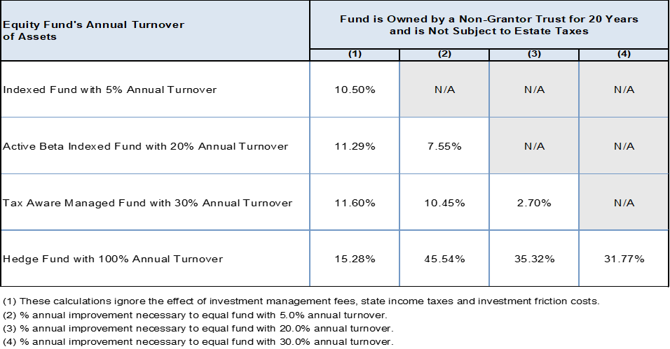
Advantages and Considerations of a Non-Grantor Trust (Continued)
Considerations of a non-grantor trust
If the transfer to the non-grantor trust is a complete gift, the transfer is subject to gifts taxes unless there is (i) an available exemption equivalent to the transfer, or (ii) if the transfer qualifies for the marital or charitable deduction
A non-grantor trust is subject to very high income taxes to the extent distributions are not made to the beneficiaries
The income tax could be mitigated with investment strategies
Invest in tax free bonds
Invest in low turnover index funds

Slide 9
Advantages and Considerations of a Non-Grantor Trust (Continued)
Invest in tax loss harvesting index like funds
Invest in variable life insurance
Invest in variable deferred annuity
Mitigate income taxes by using a two class partnership to shift income from a high income tax state to a low income tax state
Mitigate income taxes by using the drop down QSST strategy to tax the non-grantor trust at the beneficiary’s low individual income tax rate without making distributions on a net basis to the beneficiary

Slide 10
Advantages and Considerations of a Non-Grantor Trust (Continued)
In appropriate cases, mitigate income taxes by converting the non-grantor trust to a BDOT either by the sale technique to a BDOT where the non-grantor trust is the withdrawal right beneficiary of the BDOT, a decanting technique, exercise of a power of appointment by a power holder, a reformation technique, or some other means
Mitigate income taxes by converting the non-grantor trust to a grantor trust by borrowing from the trust in a manner that converts the trust to a grantor trust.
A discretionary non-grantor trust could give the trustee the power to make discretionary distributions to an existing BDOT and the trustee makes those distributions
A discretionary non-grantor trust could give the trustee the power to make discretionary distributions to a sub S corporation in which the sole owner is a QSST, in which the QSST beneficiary is also a beneficiary of the non-grantor trust, and the trustee makes those distributions

Slide 11
Advantages and Considerations of Grantor Trusts (Pages 31-97 of the Paper)
Advantages of grantor trusts
Gift tax payment of income taxes
Mismatch between gift and estate tax completion and income tax ownership
Tax-free swapping out grantor trust low-basis assets for grantor’s cash (which could be borrowed) or other high-basis assets
IRS position that grantor activities with grantor trusts are also ignored
Grantor could sell low-basis assets with appreciation potential to the grantor trust for a low interest note (SIDGT technique)
Grantor could locate income tax inefficient asset classes in a grantor trust to improve the family’s after-tax adjusted rate of return

Slide 12
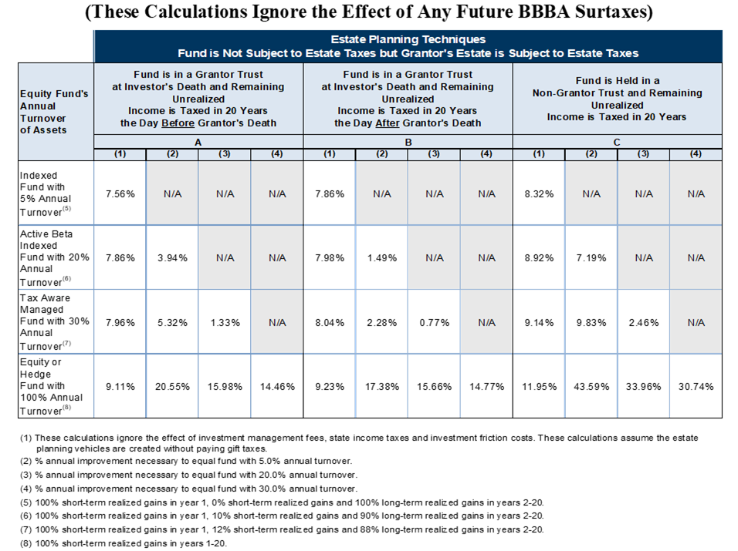
Advantages and Considerations of Grantor Trusts (Continued)
(Compare these results with the same investment classes for non-grantor trusts)

Slide 13
Advantages and Considerations of Grantor Trusts (Continued)
Grantor could borrow from a grantor trust
Source of liquidity
Borrowing could finance payment of income taxes
The borrowing occurs without income tax on interest
Grantor could purchase grantor trust’s appreciated assets from a grantor trust to make charitable gifts
Grantor could use a “reverse” installment sale to lock in the estate tax inclusion before it expires
A grantor’s borrowing could be done in a manner to generate favorable, stable returns to the trust
Considerations of borrowing from a grantor trust
Gift tax risks to grantor if interest rate is too high
Gift tax risks to beneficiaries of the trust if interest rate is too low (7872 safe harbor)
Estate tax risk if terms of the loan are too favorable and IRC Section 2036 could apply (7822 if not a safe harbor for estate tax purposes); consider the LAIDGT technique
Estate tax risk if loan is not fully deductible under IRC Section 2053(c)(3); the loan needs to be a bona fide loan

Slide 14
Advantages and Considerations of Grantor Trusts (Continued)
Considerations of sale to a grantor trust (“SIDGT”) technique
State income tax considerations
Valuation considerations
If assets decrease in value the gift tax exemption equivalent may not be recoverable
There may be gain recognition considerations with respect to the note receivable or payable at death
There will be no step-up in basis in the assets owned by the grantor trust
Valuation considerations associated with the transfer of a hard to value asset; consider define value clauses
Donor may not be able to afford income taxes in the future when the retained note from the grantor trust is paid off; donor could renounce powers that make the trust a grantor trust, which will make the trust a non-grantor trust unless the drafting of the trust provides the grantor trust will become a BDOT
When the donor dies the grantor trust becomes a non-grantor trust unless the drafting of the trust provides the grantor trust on the death of the grantor will become a BDOT
When there is significant leverage in the SIDGT technique, the IRS has argued that the principal of the note is not equal to face value and that the SIDGT gives the owner of the note who is also the grantor of the trust, under equitable tax principles, a retained interest of the trust, which makes the value of the then trust assets taxable in the grantor’s estate
Many of the considerations of the SIDGT technique may not accrue if the LAIDGT technique is used

Slide 15
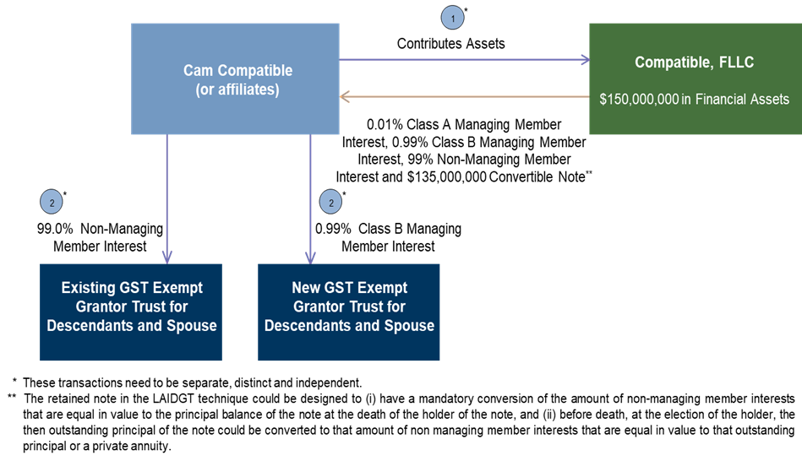
Advantages and Considerations of Grantor Trusts (Continued)
The LAIDGT technique is illustrated below

Slide 16
Advantages and Considerations of Grantor Trusts (Continued)
Income tax basis enhancing and transfer tax advantages of the LAIDGT technique
The LAIDGT has all of the income tax and basis enhancing advantages of the SIDGT technique and additional advantages that are unique to retaining a convertible note from a single member FLLC
There is greater authority that a sale to a single member FLLC in the LAIDGT technique will be treated as a non‑taxable sale to a disregarded entity for income tax purposes than there is for a sale to a grantor trust in the SIDGT technique
The retained note in the LAIDGT technique could be designed to (i) have a mandatory conversion of the amount of non-managing member interests that are equal in value to the principal balance of the note at the death of the holder of the note, and (ii) before death, at the election of the holder, the then outstanding principal of the note could be converted to that amount of non-managing member interests that are equal in value to that outstanding principal
The donor’s note is an obligation of the LLC, not the trust, which may eliminate the valuation and the trust retained interest potential arguments by the IRS in the SIDGT technique
The disregarded entity status of the FLLC, for income tax purposes, can be easily turned on or off by admitting or redeeming other owners who are not grantor trusts
There are several advantages in making the note convertible as described above
When the note is converted, that act of conversion does not trigger sale treatment. See Revenue Ruling 72-265
IRC Section 754 elective basis increase in underlying assets
Support for position regarding valuation of note
Additional investment flexibility for holder

Slide 17
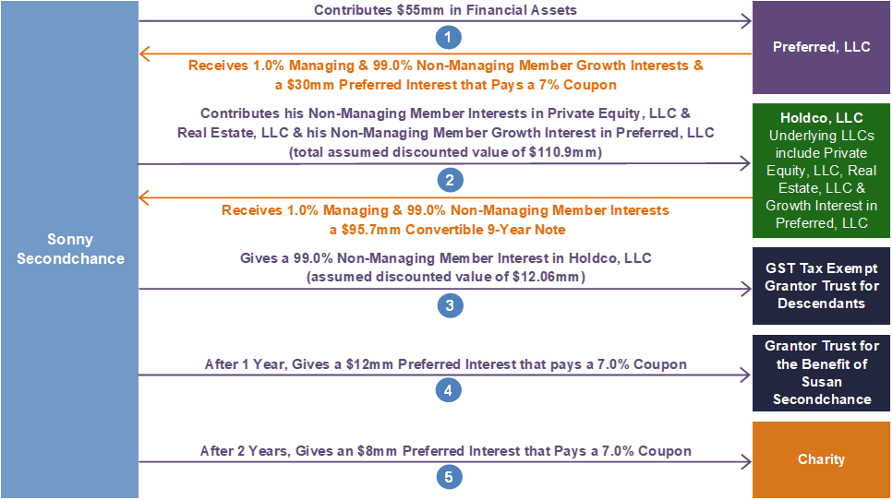
The LAIDGT Technique in Combination with Preferred Interests When One Spouse Owns Most of the Assets and the Donor Wishes to Benefit the Donor’s Family, Spouse and Favorite Charitable Causes

Slide 18
The LAIDGT Technique in Combination with Preferred Interests When One Spouse Owns Most of the Assets and the Donor Wishes to Benefit the Donor’s Family, Spouse and Favorite Charitable Causes (Continued)
Advantages of the LAIDGT technique in combination with preferred interests
Transfer tax advantages of using leverage, valuation discounts and an estate freeze in the above example compared to no further planning in which over $476,000,000 is modeled to be paid and almost no estate taxes are projected to be paid with the LAIDGT technique in combination with preferred interests
Potential IRC Section 2036 advantage of using preferred interests in the structure
There is a substantial investment purpose (i.e., non-tax purpose) with having preferred and common interests that divide the economic return of the FLP or FLLC between the owners of the interests in a different way than would result without the two interests
The donor will owe a state law enforceable fiduciary duties to a non-family owner (e.g., the charity), which are real and not illusory
The enactment of IRC Section 2036(c) in 1987 and its subsequent repeal in 1990 demonstrate that going forward Congress clearly intended to address the estate tax consequences of the preferred/common structure solely by means of the gift tax rules of Chapter 14 (IRC Section 2701) and not by including the transferred common interest in the transferor’s gross estate under IRC Section 2036(a)(1)

Slide 19
The LAIDGT Technique in Combination with Preferred Interests When One Spouse Owns Most of the Assets and the Donor Wishes to Benefit the Donor’s Family, Spouse and Favorite Charitable Causes (Continued)
Potential charitable income tax, valuation and IRC Section 2704(b)(2) advantages of preferred interest ownership by a public charity
Advantages of the technique
The donor may receive, in the year of the gift of the preferred interest to the charity, an income tax deduction for the discounted present value of the charity’s right to receive the par value of the preferred on termination of the FLLC, even though that might occur after the donor’s death
The donor should receive an income tax charitable deduction, in the year of the gift, for the discounted present value of the coupons that are to be paid to charity in the future
In addition to receiving an upfront charitable income deduction for the present value of the annual coupon of the preferred that is paid to the charity, the donor also receives an indirect second annual deduction each year with respect to the future preferred coupon payments against his income and health care because of the partnership tax accounting rules under IRC Section 704(b)
The donor will also avoid the built-in capital gains tax on the sale of any low basis asset that is contributed for the preferred interest
The “out-of-pocket” cost of a gift of a preferred interest to a public charity, or donor advised fund, is much less than comparable cash gifts, because of the above tax advantages; in this example, over $7,500,000 in income taxes and opportunity costs will be saved in comparison to giving cash of the same amounts at the same time to charity
Income tax valuation advantage: IRS concedes preferred partnership interests should have a high coupon
Another advantage is that both the Tax Court and the 5th Circuit Court have held that IRC Section 2704(b)(2) prohibitions against applicable restrictions in a partnership do not apply because of operation of IRC Section 2704(b)(3)(B) since a non-family member (a charity) owns a preferred interest

Slide 20
The LAIDGT Technique in Combination with Preferred Interests When One Spouse Owns Most of the Assets and the Donor Wishes to Benefit the Donor’s Family, Spouse and Favorite Charitable Causes (Continued)
Charitable considerations of the LAIDGT technique in combination with preferred interests
Despite state property law, the IRS may take the position that the gift of the preferred interest of an FLLC to public charities should be considered a non-deductible partial gift of the underlying assets of the FLLC
There are numerous business and financial reasons to form a partnership or FLLC as an advantageous vehicle for, and being in the best interests of, the members of a family, including consolidation of the management and control of family assets within a partnership owned by the eventual owners of all of the assets; avoidance of fractional asset ownership over time; greater creditor protection; greater ability to keep assets in the family, etc. The more of these factors that are applicable to any proposed FLLC the less likely the contribution of preferred units will be attacked as a prohibited gift of partial interests
The more participants in the FLLC the more likely it was created for purposes independent of obtaining a charitable deduction and the less likely the IRS will deny the charitable contribution as a gift of a partial interest
Other factors that could bolster the argument that the FLLC was not created for purposes only related to dividing the economic interests of the contributed property to the FLLC in order to circumvent the partial interest rule, is the longevity of the FLLC before gifts are made to charity and the retention of some of the preferred interest by the donor
If the gift of the preferred interest is to a donor advised fund (instead of some other public charity) care should be taken to make sure there is not a tax on excess business holdings under IRC Section 4943
The taxpayer must comply with certain reporting requirements in order to receive a deduction for the fair market value of the donated preferred interest

Slide 21
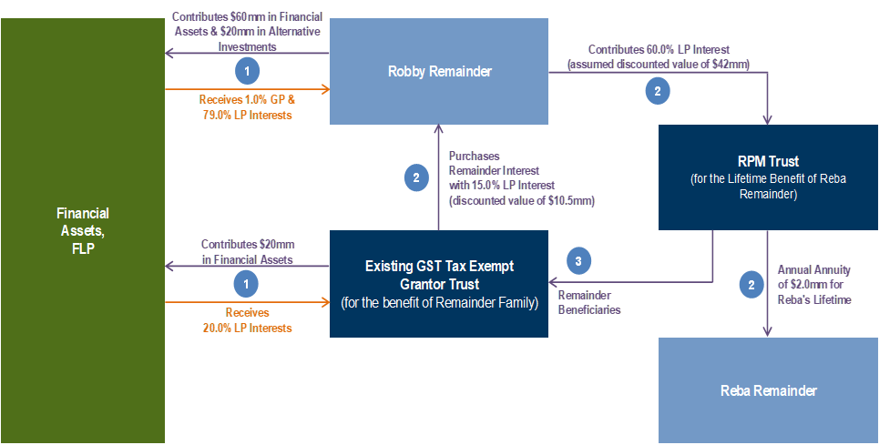
The Advantages and Considerations of a RPM Grantor Trust Technique When One Spouse Owns Most of the Assets
The RPM technique is illustrated below
It is important that Reba Remainder only has a straight income or annuity interest in the RPM Trust
IRC Section 2523(b)(1) provides that no gift tax marital deduction is allowed if the spouse receives a life estate or other interest in a trust and upon termination of the trust the trust assets pass to someone else “for less than adequate and full consideration in money or money’s worth” (the so-called “terminable interest rule”). Thus, in order to not run afoul of the terminable interest rule, it is crucial that full consideration be paid for the remainder interest of the RPM Trust

Slide 22
The Advantages and Considerations of a RPM Grantor Trust Technique When One Spouse Owns Most of the Assets (Continued)
Advantages of the RPM technique
Tax advantages of creating a grantor trust and transferring assets to the grantor trust with significant lifetime leverage, which could result in a significant amount being transferred to the remainder trust net of transfer taxes, in this example over $77,000,000 in estate taxes are projected to be saved
The near term death of the grantor, or the grantor’s spouse, generally does not affect the technique like the death of a grantor of a GRAT
The appreciation of the assets will be out of the grantor’s estate and the spouse of the grantor’s estate
The grantor and the grantor’s spouse will have available for their consumption needs the consideration paid by the Remainderman Trust and the distributions paid pursuant to the beneficial provisions of the RPM Trust (and perhaps the Remainderman Trust)
There is more flexibility in the design of the structure in comparison to a grantor retained annuity trust that meets the requirements of IRC Section 2702 (“GRAT”) because IRC Section 2702 does not apply to the technique and it is easier to do leveraged GST planning in comparison to a GRAT

Slide 23
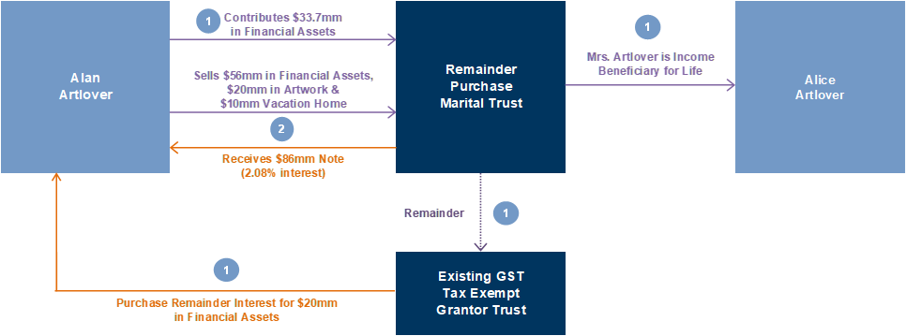
The Advantages and Considerations of a RPM Grantor Trust Technique When One Spouse Owns Most of the Assets (Continued)
The life estate version of the technique could also serve as a qualified personal residence trust (QPRT) substitute and could be a very good vehicle for planning for art
The technique would have a mortality advantage over a qualified personal residence trust under IRC Section 2702 (“QPRT”) because there is no mortality risk, if the donor of the spouse dies during the term
Limitations under a QPRT for what constitutes a personal residence and the two-residence limit also would not apply
After the RPM Trust ends the donor (if then living) could purchase the house and the art back from the Remainderman Trust (designed to be a grantor trust), which is prohibited by the QPRT rules. Unlike a QPRT, the RPM Trust would not have to be converted to an annuity trust if the residence is sold during the term of the RPM Trust
There should not be any capital gains taxes associated with the donor’s sale of the personal residence, or the art, because the RPM Trust will be treated as a grantor trust to the donor under IRC Section 677(a)
There may be gift tax consequences if the consideration received for the RPM Trust is not equal to the fair market value of the donor’s residence or art that is sold. The use of a defined value allocation formula in the sale assignment may ameliorate the gift tax concern

Slide 24
The Advantages and Considerations of a RPM Grantor Trust Technique When One Spouse Owns Most of the Assets (Continued)
Considerations of the RPM Technique
It requires a spouse beneficiary
The RPM Trust cannot have a divorce clause, but it could be an advantageous technique to use in pre‑divorce planning
It is crucial that the Remainderman Trust pay full consideration
The step transaction doctrine could apply
If the Remainderman Trust is funded by the Grantor of the RPM Trust, it is very important that the Remainderman Trust be an old and cold trust at the time it purchases its remainder interest. It needs to be funded independent of the RPM Trust transaction so that the remainder interest in the RPM Trust is deemed transferred for full consideration: absent full consideration for the remainder, the gift tax marital deduction may not be allowed for the transfer to the spouse of the term interest in the RPM Trust, because the nondeductible terminable interest rule may be deemed to apply
The need for “substance” with respect to the purchase by the Remainderman Trust
It is crucial that the remainder and term interests in the RPM Trust be transferred simultaneously
The interest on the note received by the selling spouse will be taxable income to that selling spouse and there will be a corresponding deduction to the spouse who created the grantor trust
The RPM Trust transaction will only be a profitable transaction to the Remainderman Trust if the assets subject to the remainder purchase grow faster than what the consideration utilized by the Remainderman Trust would have otherwise increased

Slide 25
The Advantages and Considerations of a Transferor Creating a Grantor Trust for the Benefit of the Transferor’s Spouse and That Transferor’s Spouse Creates a Grantor Trust for the Benefit of the Transferor That is Not Reciprocal of the Trust the Transferor Created
Considerations if the Reciprocal Trust Doctrine applies, the spouse beneficiary of the trust will also be considered the grantor of the trust and the transfer tax advantage of the technique will be lost
The Supreme Court’s opinion in Grace sets forth the two part test for the application of the reciprocal trust doctrine: (i) the trusts must be interrelated and (ii) the trusts arrangement, to the extent of mutual value, must leave the settlors in approximately the same economic position as if they had created the trust naming themselves as the life beneficiaries
If the reciprocal trust doctrine applies, the transfer tax result is determined by “uncrossing” the transfers
The Supreme Court in Grace considered three factors that were present under the Grace facts, which were indicators that the trusts were interrelated: (i) creation of the trusts at approximately the same time, (ii) the fact that trusts had substantially identical terms, and (iii) they were part of a single transaction designed and carried out by the decedent. Other factors the Court considered included the identity of the beneficiaries and the trustees
Advisors typically take into account all of the following crucial considerations in order to not run afoul of the reciprocal trust doctrine
The spouses may wish to use fundamentally different types of estate planning techniques in order to fund trusts for the other spouse
Consider having different vesting options with respect to the two trusts
Consider different distribution options

Slide 26
The Advantages and Considerations of a Transferor Creating a Grantor Trust for the Benefit of the Transferor’s Spouse and That Transferor’s Spouse Creates a Grantor Trust for the Benefit of the Transferor That is Not Reciprocal of the Trust the Transferor Created (Continued)
Consider different powers of appointment
Consider different beneficiaries other than husband and wife
Consider having different trustees of the two trusts
Consider having different assets in the two trusts
Consider having substantive timing differences as to the creation of the two trusts
Consider having substantial timing differences before one of the spouses becomes a beneficiary of each trust
Obviously, the greater the differences between the two trusts the greater the chance that the reciprocal trust doctrine will not be applied
The safest approach is generally thought to be for only one spouse to create a trust for the benefit of the other spouse and to rely on other planning techniques (e.g., converting the note into a private annuity for the benefit of one spouse) to give the flexibility that a couple desires

Slide 27
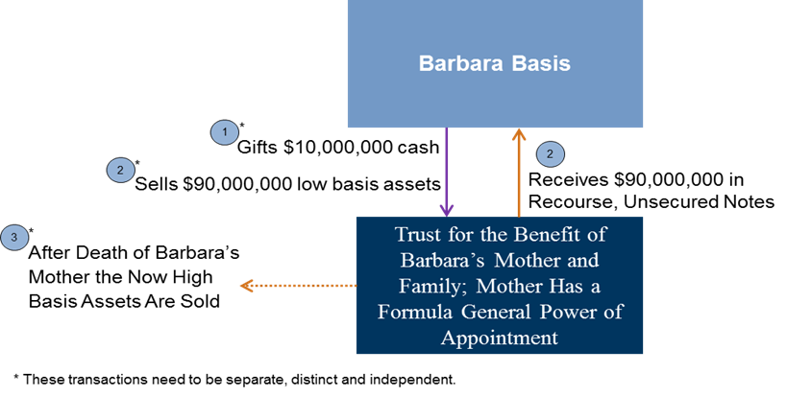
The Gifting and Selling Low Basis Assets to a Grantor Trust Where an Older Generation is a Beneficiary and is Subject to an Older Generation’s General Power of Appointment and Estate Taxes (“UPIDGT”) Technique
The UPIDGT technique is illustrated below
Income tax and basis enhancing advantages of the UPIDGT technique
This technique has the same advantages as a SIDGT
The assets of the trust will receive a step-up in basis on the older generation beneficiary’s death equal to the fair market value of the assets, if net value rule of Treas. Reg. §2053-7 does not apply
Transfer tax advantages of the UPIDGT technique
The assets of the trust may be generation-skipping tax protected
The older generation beneficiary may not have to pay estate taxes because of her general power of appointment, if her then available unified credit exceeds the net value of the trust
Also consider the income and transfer tax advantages that could accrue if the older generation exercises her testamentary formula general power of appointment in favor of a BDOT in which the younger generation creator of the UPIDGT is the initial beneficiary

Slide 28
The Gifting and Selling Low Basis Assets to a Grantor Trust Where an Older Generation is a Beneficiary and is Subject to an Older Generation’s General Power of Appointment and Estate Taxes (“UPIDGT”) Technique (Continued)
Considerations of the UPIDGT technique
The grantor of the trust will still have a low basis in his or her note upon the death of the older generation beneficiary
The older generation beneficiary could exercise his or her general power of appointment in an unanticipated way
Many of the same considerations for the use of a grantor trust and a sale to a grantor trust would also be present for this technique
The effect of IRC Section 1014(e) must be considered, if cash is not given and low basis assets are used to capitalize the trust
Is grantor trust status lost for the original grantor when the older generation beneficiary dies and the trust assets are included in the beneficiary’s estate?
IRC Section 1014(b)(9) needs to be considered for property that has depreciated

Slide 29
The Advantages and Considerations of a Transferor Selling Assets to a Trust That Names the Transferor as a Beneficiary, Gives the Transferor a Testamentary Special Power of Appointment and Under Which the Transferor’s Spouse is Considered the Income Tax Owner (“Spousal Grantor Trust”) (Pages 97-104 of the Paper)
If the taxpayer is a beneficiary of a spousal grantor trust and holds a power of appointment over its assets, the taxpayer’s sale of property to the trust will permit the taxpayer to benefit from the property’s future income and appreciation and to direct how others will enjoy it without exposing the property’s income or appreciation to estate tax in the estate of either spouse
Because the spouse will be liable for the income tax attributable to the spousal grantor trust’s investment income, the value of the property in the trust will be able to generate tax free returns for its spouse beneficiary and remainder beneficiaries as long as the trust is a grantor trust
Beneficiary sales to a Spousal Grantor Trust may constitute effective estate planning. It is an attractive estate planning technique because it has the advantages of the SIDGT technique with the additional advantage that the selling taxpayer is also a beneficiary of the trust

Slide 30
The Advantages and Considerations of a Spousal Grantor Trust (Continued)
Advantages of a Spousal Grantor Trust
Transfer tax advantage of the technique
Even though the selling spouse is a beneficiary, the assets that are sold will not be included in the selling spouse’s estate if the sale is for adequate and full consideration. Easy to value assets that are sold can easily be sold for adequate and full consideration
Income tax advantages of the technique
There will be no capital gains consequence on the original sale of the assets to the trust
A sale to a Spousal Grantor Trust should not be recognized for income tax purposes because of IRC Sections 1041 and 671
However, interest on notes issued as consideration for a sale to a spousal grantor trust will be recognized for income tax purposes, because IRC Section 1041 does not prevent inter-spousal interest from being taxable. Generally, assuming the asset sold to the spousal grantor trust is itself an investment asset, the interest will produce an offsetting deduction and income to the spouses. The principal and income of the notes can be paid with cash flow that is naturally distributed to the partners in order to pay their income taxes
By using basis enhancing techniques the basis of the taxpayer’s assets may be increased
The technique has the asset class location advantage of the SIDGT technique

Slide 31
The Advantages and Considerations of a Spousal Grantor Trust (Continued)
Considerations of a Spousal Grantor Trust
Federal income tax considerations
As noted above, the sale to a Spousal Grantor Trust should be income tax free. However, the seller will be taxed on the interest on the note. As long as the seller spouse is living, he or she should receive a corresponding deduction on the interest on the note. Thus, assuming the spouses file joint returns, the interest income and the interest deduction should be a “wash” in most circumstances
State income tax considerations
It is prudent to file gift tax returns
Reciprocal trust doctrine considerations
When the spousal grantor dies then the trust becomes a non-grantor trust unless the original drafting of the trust provides that the trust becomes a BDOT. If the trust becomes a non-grantor trust, then the trust has the high income taxes of a non-grantor trust and the other considerations of a non-grantor trust
Sales of trust assets by the beneficiary spouse must be for full and adequate consideration or those sold assets will be included in the beneficiary spouse’s estate subject to a consideration offset provided by IRC Section 2043

Slide 32
The Advantages and Considerations of the BDOT Under IRC Section 678(a)(1)
IRC Section 678(a)(1) overview
IRC Section 678(a)(1) provides as follows:
“(a) General rule A person other than the grantor shall be treated as the owner of any portion of a trust with respect to which:
(1) such person has a power exercisable solely by himself to vest the corpus or the income therefrom in himself. . .” (Emphasis added)
The reference to “income” in Section 678(a)(1) is taxable income and not accounting income. If a beneficiary of a BDOT has the right to withdraw taxable income, the beneficiary has the right to withdraw not only dividends and interest, but income normally allocated to principal such as capital gains income
Consider the following provisions of a BDOT:
The primary beneficiary has the power for all portions of the trust “to vest the income therefrom” (as that phrase is used in IRC Section 678(a)(1)) in any calendar year of the trust to the primary beneficiary. If that power to vest the income of the trust in a calendar year of the trust is not exercised in a calendar year that power shall lapse. The power to vest the income from all portions of the trust includes the power to withdraw in any calendar year of the trust all of the income of the trust earned by all of the trust assets, whether the income is ordinary or capital gains income. That withdrawal power, if exercised, can be satisfied by the trustee by distributing to the primary beneficiary the accounting income, corpus assets and/or proceeds of the corpus of all portions of the trust. The independent trustee (or protector) may amend the trust to terminate the primary beneficiary’s right to vest the income of the trust for any period of time, but any termination shall be prospective and shall only affect the right to vest the income of the trust accruing after the effective date of the amendment

Slide 33
The Advantages and Considerations of the BDOT Under IRC Section 678(a)(1) (Continued)
What does it mean for a “portion” to be treated as owned under IRC Section 678(a)(1)?
In the context of the holding of Rev. Rul. 85-13 what does the term “portion” mean when that term is used in IRC Section 678(a)(1)? Does it mean, under IRC Section 678(a)(1), “income” portion as opposed to “corpus” portion that the beneficiary is the deemed income tax owner of? Or does it mean, under IRC Section 678(a)(1), that undivided interest of the trust that the beneficiary is the deemed income tax owner in which a beneficiary could vest in himself either that undivided interest’s corpus income or ordinary income? It would appear that it means the beneficiary is the deemed owner for income tax purposes of that undivided interest of the trust
Perhaps the beginning point of the analysis of what is the meaning of the term “portion” under IRC Section 678(a)(1), is Treas. Reg. § 1.678(a) 1(a). The key part of the first sentence of that regulation provides “where a person other than the grantor of a trust has a power exercisable solely by himself to vest … the income of any portion of a … trust in himself, he is treated under section 678 (a) as the owner of that portion ….” (Emphasis added”)
The last sentence of Treas. Reg. § 1.678(a)-1(a) incorporates, for purposes of IRC Section 678(a)(1), the grantor trust rules, which describe generally how the income tax rules work under IRC Section 671(a)(1) for any deemed income tax owner of any portion of a trust under IRC Section 671, Treas. Reg. §§ 1.671-2 and 1.671-3. These rules apply also in determining the treatment for any deemed income tax owner of any portion of an IRC Section 678(a)(1) trust: “See [IRC] 671 and [Treas. Reg.] §§ 1.671-2 and 1.671-3 for rules for treatment of items of income, deductions and credit where a person is treated as the owner of all or only a portion of a trust”
See also Treas. Reg. § 1.1001-2(c) Example 5, which established by regulation the position in Rev. Rul. 77-402 that the grantor of a grantor trust is “the owner of all property for federal income tax purposes.” Presumably, that is true even if the grantor of the grantor trust only has powers or rights over the ordinary income and capital gains income of the trust and does not have powers or rights over the corpus of the trust. See IRC Sections 677(a)(1) and (a)(2)

Slide 34
The Advantages and Considerations of the BDOT Under IRC Section 678(a)(1) (Continued)
Similar to IRC Sections 677(a)(1) and (a)(2), under IRC Section 678(a)(1), an Income Withdrawal Right Beneficiary of a BDOT may only have the right to vest taxable income (i.e., ordinary income and capital gains income), and not corpus, in himself, but that is enough for the Income Withdrawal Right Beneficiary to be the deemed owner for income tax purposes of all of the trust property
If IRC Section 671, Treas. Reg. §§ 1.671-2 and 1.671-3 are incorporated in analyzing the operation of IRC Section 678, then the rationale of Rev. Rul. 85-13 for not recognizing a taxable sale by the deemed owner would also seem to apply. Since an Income Withdrawal Right Beneficiary has the power to withdraw the taxable income from all trust assets and the power to satisfy that withdrawal right from either the accounting income, sale proceeds of the corpus, or the corpus of all portions of the trust, that Income Withdrawal Right Beneficiary should be the deemed income tax owner of all of the assets of the subject trust, including any consideration that is sold to the trust. It does not matter under Rev. Rul. 85-13 whether IRC Section 671 applies because of a grantors retains rights and powers over corpus, corpus and income, or ordinary income and capital gains income only (see IRC Section 677)
Sales to a Single-Member LLC owned by grantor trusts or BDOTs as alternative technique if Rev. Rul. 85-13 is revoked by the IRS or deemed not to apply to BDOTs
Rev. Rul. 85-13 is an IRS analysis of a grantor deemed owner trust and whether activities and transactions by a grantor are disregarded. However, under IRC Sections 671-678 and the regulations thereunder, there is no explicit authority that activities and transactions by a grantor are to be disregarded. What if the IRS argued that it is not bound by Rev. Rul. 85-13 with respect to an Income Withdrawal Right Beneficiary of a BDOT and it will follow the analysis in Rothstein?

Slide 35
The Advantages and Considerations of the BDOT Under IRC Section 678(a)(1) (Continued)
If the taxpayer is worried about that potential IRS argument, the taxpayer should consider selling to a single member LLC that is created by a BDOT in which the taxpayer is considered the deemed income tax owner. It appears the writer of the regulations in 1996, dealing with single member LLCs, clearly rejected the Rothstein court’s analysis, which was decided 12 years earlier, with respect to activities and transactions with single member LLCs
“Its activities are treated in the same manner a sole proprietorship . . . of the owner. (Emphasis added)
Assuming the Income Withdrawal Right Beneficiary of a BDOT is considered the income tax owner of any single member LLC formed by the BDOT (see the above analysis), then the above single member LLC income tax regulations would appear to be authority for the proposition that any sale or similar activity by the Income Withdrawal Right Beneficiary of a low basis asset to a single member LLC owned by a BDOT should also be disregarded
Assuming the Income Withdrawal Right Beneficiary of a BDOT is considered the income tax owner of any single member LLC formed by the BDOT (see the above analysis), then the above single member LLC income tax regulations would appear to be authority for the proposition that any sale or similar activity by the Income Withdrawal Right Beneficiary of a low basis asset to a single member LLC owned by a BDOT should also be disregarded
Summary of conclusions
Case law, regulatory and revenue ruling authorities provide that if a taxpayer sells an asset, and if that taxpayer is deemed to be the income tax owner of that asset both before and after the sale, that sale is disregarded for income tax purposes
IRC Section 678(a)(1) provides that a person who has the right to vest income of an undivided portion of a trust shall be treated as the income tax owner of that undivided portion

Slide 36
The Advantages and Considerations of the BDOT Under IRC Section 678(a)(1) (Continued)
Since IRC Section 678(a)(1) and Treas. Reg. § 1.678(a) 1 provide that IRC Section 671, Treas. Reg. §§ 1.671-2 and 1.671-3 apply to an IRC Section 678(a)(1) trust, the Income Withdrawal Right Beneficiary of the IRC Section 678(a)(1) trust should be treated the same as a grantor of a grantor trust. There do not appear to be any income tax differences between a corpus withdrawal beneficiary and an Income Withdrawal Right Beneficiary of the IRC Section 678(a)(1) trust
There is no specific regulatory authority under either IRC Section 671, Treas. Reg. §§ 1.671-2 or 1.671-3 that activities and transactions that either a grantor of a grantor trust has with that grantor trust, or an Income Withdrawal Right Beneficiary has with an IRC Section 678(a)(1) trust, are to be disregarded for income tax purposes. There is case law authority that those activities should not be disregarded. See Rothstein v. United States, 735 F.2d 704 (2nd Cir 1984)
There is authority under Rev. Rul. 85-13, 1985-1 CB 184 that activities and transactions that a grantor has with a grantor trust are disregarded because the taxpayer owns, or is deemed to own, the asset before and after the transaction. The analysis inherent in that revenue ruling should indicate that activities and transactions that an Income Withdrawal Right Beneficiary has with an IRC Section 678(a)(1) trust should also be disregarded. PLR 202022002 (May 29, 2020) arguably supports that analysis
There is specific regulatory authority that activities and transactions that a deemed income tax owner of a single member LLC has with that LLC are disregarded for income tax purposes. That regulatory authority is broader than the regulatory authority that exists for activities and transactions a grantor has with a grantor trust. That regulatory authority is also broader than the regulatory authority that exists for activities and transactions an Income Withdrawal Right Beneficiary has with an IRC Section 678(a)(1) trust
Failing to take the withdrawing income is not relevant to the IRC Section 678 analysis
The BDOT can be designed to be very flexible for any calendar year by giving an independent trustee, or a protector, the power to change the withdrawal power for a future year or years

Slide 37
The Advantages and Considerations of the BDOT Under IRC Section 678(a)(1) (Continued)
Further overview of the BDOT technique
A third party could create an inter vivos or testamentary estate tax protected trust, of any value, in which the beneficiary is the deemed income tax owner
This technique allows significant initial funding, which is different than the BDIT, which generally is only funded with $5,000 of assets when it is created
Under IRC Section 678(a)(1), if a beneficiary of a third party created trust has the unilateral power to “vest income” of all portions of the trust in himself, then the trust is disregarded for income tax purposes, the beneficiary is treated as the owner of all of the trust assets, and the net taxable income of the trust is taxable to the beneficiary
In order to vest income of the trust, the beneficiary of the trust should have the unilateral power to withdraw all of the net taxable income of the trust to himself, with all of the assets of the trust being available to satisfy that withdrawal power, including the trust’s accounting income, the trust’s corpus and the trust’s proceeds from sales of the trust corpus
Income tax comparison to a grantor’s sale of assets to a trust that is a grantor trust because of IRC Section 677 to a beneficiary’s sale of assets to a BDOT
Assume a grantor of a trust sells assets to a trust which gives the grantor the right to withdraw all realized income of the trust from whatever the source, including all accounting income and realized capital gains income of that trust. That withdrawal right could be satisfied from any asset or cash source of the trust, including accounting income, sale proceeds of the corpus and the corpus. That sale should be disregarded for income tax purposes, because, as the holding of Rev. Rul. 85-13 states, “the same person owns the asset for income tax purposes before and after the sale,” and also because of the authority of IRC Sections 671, and 677, Treas. Reg. §§ 1.671-2, 1.671‑3, 1.677(b)(2), 1.677(c)(2), and 1.677(g), example 2. Likewise, a sale by a beneficiary of a trust to a trust in which the beneficiary has the same withdrawal right that the grantor has in the above example, should be disregarded under the authorities noted in IRC Section 678, and Treas. Reg. § 1.678(a) 1, because the beneficiary is treated as owning the asset that is sold for income tax purposes both before and after the transaction. Furthermore, if there is a sale by the beneficiary of a BDOT to a LLC, in which the sole owner of the LLC is that BDOT, there is greater authority under the Treasury Regulations that the sale is disregarded than the sale by a grantor to a grantor trust

Slide 38
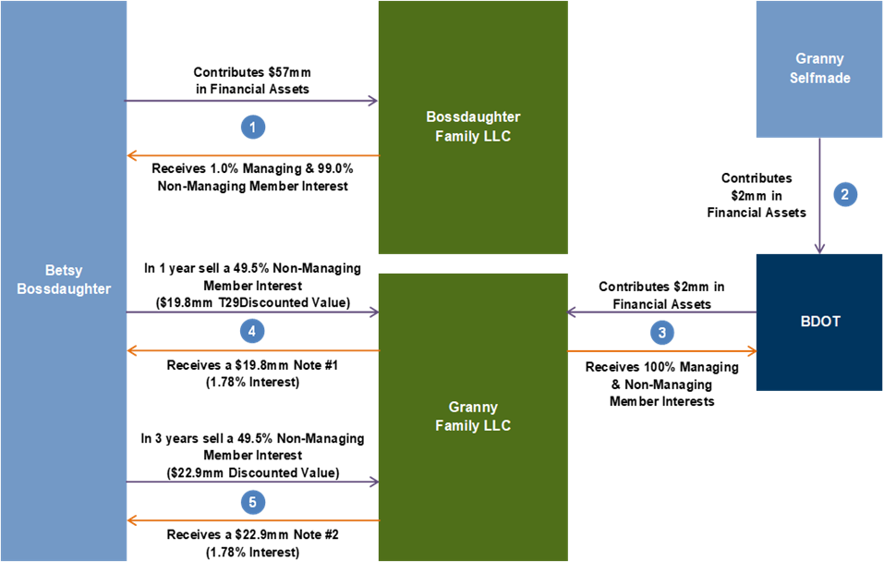
The Advantages and Considerations of the BDOT Under IRC Section 678(a)(1) (Continued)
Transfer tax advantages of sales to LLCs owned by BDOTs:
If Betsy lives 30 years, over $54,000,000 in estate taxes will be saved without using any of her exemption

Slide 39
The Advantages and Considerations of the BDOT Under IRC Section 678(a)(1) (Continued)
The beneficiary has the opportunity by her actions to increase the value of the BDOT and, thus, the amount that is not subject to estate taxes
To the extent the beneficiary of a BDOT does not withdraw net taxable income of the BDOT up to the lapse protection (the so-called “5 and 5” protection of IRC Section 2514(e)(2) and IRC Section 2041(b)(2)), that amount remains in the trust in a manner that will not be subject to gift taxes and estate taxes. Almost all states have legislation that protects the protected lapse portion described in IRC Sections 2514(e)(2) and 2041(b)(2) from creditors
Because the beneficiary is the deemed income tax owner of the BDOT, there is flexibility to allow the beneficiary to sell life insurance policies to the BDOT
A sale by an income right withdrawal beneficiary to a BDOT Has all of the transfer tax advantages of a LAIDGT
The BDOT technique has a greater safety valve than the SIDGT or a LAIDGT for protecting the seller, since the seller both has withdrawal rights in and is a beneficiary of the BDOT
The BDOT technique may be able to be used to transfer assets from a trust that is a non-grantor trust to a newly created trust
Can a trust be a deemed owner of another trust under IRC Section 678 under the treasury regulations? Yes
A BDOT may be able to be used as an exit strategy from a closely held family C corporation
Consider using the BDOT technique, in combination with an accumulation trust, to facilitate IRA planning for descendants
After passage of the Secure Act, IRAs must terminate in 10 years for descendants who are older than the age of majority
A conduit trust for a descendant who is older than the age of majority will terminate in 10 years

Slide 40
The Advantages and Considerations of the BDOT Under IRC Section 678(a)(1) (Continued)
An accumulation trust for a descendant will not have to terminate in 10 years. However, the balance in the subject IRA will all be paid to the accumulation trust after 10 years which will be taxed at the trust’s high tax rate
If the accumulation trust for the descendant is designed to be a BDOT, the IRA proceeds will be taxed at the descendant’s income tax rates, which may be much lower than the trust’s income tax rates
In future years the taxable income of the trust will also be taxable at the descendant’s income tax rates, which may be much lower than the trust’s income tax rates
If the beneficiary withdraws from the trust only that amount necessary to pay income taxes associated with the trust, the beneficiary will maximize the creditor protection and other benefits of the trust
Using the BDOT technique to lengthen the transfer tax and income tax benefit of a grantor trust in which the grantor’s spouse is a beneficiary
A grantor trust could be drafted to provide that the trust’s grantor’s spouse becomes an “income withdrawal beneficiary” of a BDOT after the grantor trust is no longer a grantor trust because of the grantor’s death
If this technique is used, the grantor should also bequeath any outstanding notes in which the grantor is the creditor of the subject trust to the grantor’s spouse who becomes the “income withdrawal beneficiary”
Using the BDOT technique to lengthen the transfer tax and income tax benefit of a grantor trust in which there is a primary beneficiary, other than the grantor’s spouse
A grantor trust could be drafted to provide that the trust’s primary beneficiary becomes an “income withdrawal beneficiary” of a BDOT after the grantor trust is no longer a grantor trust because the retained powers by the grantor no longer apply because the grantor renounces the retained power that make it a grantor trust, or because of the grantor’s death
If this technique is used, the grantor should also bequeath any outstanding notes in which the grantor is the creditor of the subject trust to the primary beneficiary who becomes the “income withdrawal beneficiary

Slide 41
The Advantages and Considerations of the BDOT Under IRC Section 678(a)(1) (Continued)
Additional Income tax advantages of the BDOT technique
The technique has all of the income tax advantages of the SIDGT technique or the LAIDGT technique
The BDOT is treated as a grantor trust to the beneficiary based on IRC Section 678, which is basically a codification of the Mallinckrodt case. Thus, a sale by the beneficiary of the BDOT to the BDOT, under the regulations under IRC Sections 671-677, 678 and 1001, would appear to have the same advantages as the SIDGT technique or the LAIDGT technique
The BDOT has many income tax advantages that a complex trust does not have
The taxable income is taxed at the beneficiary’s marginal income tax rate, which is frequently lower than the trust’s marginal federal income tax rate
The taxable income is taxed at the beneficiary’s marginal state income tax rate, which is frequently lower than the trust’s marginal state income tax rate
The beneficiary may move to a state with low or no state income taxes and the concerns with a high-income tax state’s “resident trust” requirement would be eliminated
The beneficiary of a BDOT can take an IRC Section 179 expense deduction while a complex trust’s ability to take that deduction is limited
Depending upon the BDOT beneficiary’s tax bracket, and/or how active the beneficiary is in a closely held business, the 3.8% net investment income tax may not apply while under the same circumstances it may apply to a complex trust

Slide 42
The Advantages and Considerations of the BDOT Under IRC Section 678(a)(1) (Continued)
The BDOT can be a shareholder of an S corporation without some of the considerations of an ESBT or a QSST
The beneficiary of a BDOT may be entitled to certain deductions that are eliminated by ESBTs. A QSST has to pay the trust accounting income of the QSST to the beneficiary, while a BDOT does not pay any income to the beneficiary unless the withdrawal right is exercised
Capital losses can be passed through to the beneficiary of the BDOT
Assets that have a capital loss could be distributed in kind
The capital gains benefit of a residence that is inherent under IRC Section 121 will be available to sales of residences owned by a BDOT
There are increased opportunities for charitable planning because the inherent limitations under IRC Section 642(c) will be eliminated
The beneficiary can withdraw assets that accrued from sources other than gross income in satisfaction of its withdrawal rights, and those assets can then be contributed by the beneficiary to charities
A BDOT should avoid overlapping state fiduciary income taxation
The beneficiary-owner, however, could be subject to overlapping state individual income taxation
Other uses of beneficiary-owned trusts
Interest-free loans to beneficiary
Beneficiary ownership of state source income

Slide 43
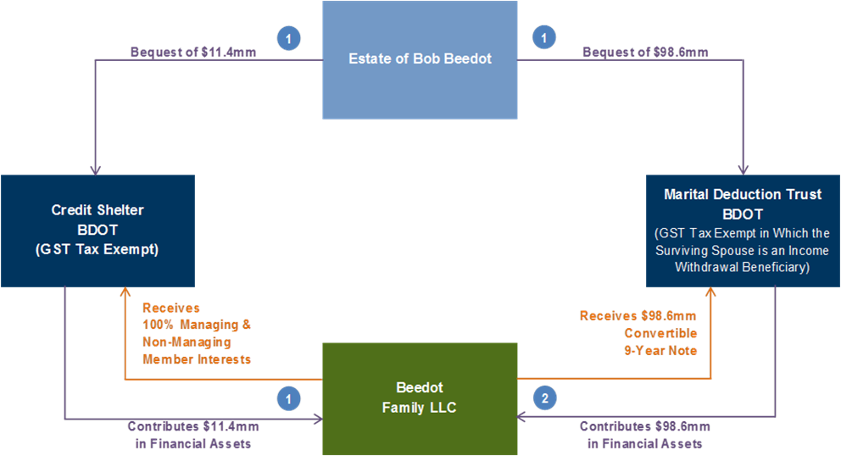
The Advantages and Considerations of the BDOT Under IRC Section 678(a)(1) (Continued)
Post-mortem uses of BDOTs
BDOT trusts created by deceased spouse for the surviving spouse
In standard credit shelter trust planning, both the credit shelter trust and the QTIP marital deduction trust could be designed to be a BDOT for the benefit of the surviving spouse; the credit shelter trust could contribute its assets to an LLC; and, after that contribution, the QTIP marital deduction trust could sell its assets to the LLC owned by the credit shelter trust
The technique is illustrated below:

Slide 44
The Advantages and Considerations of the BDOT Under IRC Section 678(a)(1) (Continued)
Income tax and basis enhancing advantages of the post-mortem BDOT technique
There is a step-up in basis of the deceased spouse’s assets at his death. This technique is particularly advantageous for a taxpayer who has a low basis or a negative basis asset, because it does not require a lifetime transfer of assets. There will be a step-up in basis that is equal to the fair market value of the assets
There is an opportunity through using borrowing strategies from third party lenders for the surviving spouse to increase the basis of the family’s assets during her lifetime
All of the income tax and basis enhancing advantages of creating a grantor trust are present with this technique
Transfer tax advantages of the post-mortem BDOT technique
Significantly more assets may be passed to the next generation by using this technique than using the exemption to fund a credit shelter trust that is taxed as a complex trust and a QTIP marital deduction trust that is taxed as a complex trust
The surviving spouse’s rights with respect to assets owned by the QTIP marital deduction trust and the credit shelter trust, and cash flows produced by those assets, are substantial
Considerations of the post-mortem BDOT technique
This technique has the same considerations as the creation of a BDOT and a sale to an LLC owned by a BDOT
Like all leverage techniques, if the underlying assets stay flat or decline there is not any advantage to the technique and to the extent a gift tax exemption is used, the technique operates at a disadvantage, unless gross estate inclusion can be toggled on in order to restore gift tax exemption
The QTIP marital deduction trust must also give the surviving spouse the right to withdraw all the trust’s accounting income for life in addition to giving the surviving spouse the right to withdraw the net taxable income for life
A spouse’s right to withdraw accounting income satisfies the regulations applicable to marital trusts, including QTIP trusts

Slide 45
The Advantages and Considerations of the BDOT Under IRC Section 678(a)(1) (Continued)
Considerations for all BDOT techniques
Avoiding a wealth transfer tax caused by lapse of a general power
In order to receive the lapse of power transfer tax protection of IRC Sections 2041(b)(2) and 2514(e)(2), it is important that the withdrawal power applies against all of the income earned by all of the BDOT trust assets and can be satisfied from the trust’s accounting income, sale proceeds of the corpus of the BDOT trust, and corpus of the BDOT trust. Because the beneficiary has a right to withdraw trust income, IRC Section 2036(a) could apply to a contribution to the trust by the beneficiary other than a bona fide sale for full and adequate consideration. It is therefore important that any withdrawable, but untaken, BDOT funds be protected from being considered a contribution by the beneficiary of the BDOT for transfer tax purposes
The requirements under the tax law for those withdrawable, but untaken, BDOT funds to not be considered a transfer for transfer tax purposes are: (i) those BDOT funds cannot exceed more than 5% of the value of the property of the BDOT; (ii) those BDOT funds could have been paid from the entire property, or proceeds from the property, of the BDOT, and (iii) creditors cannot reach those BDOT funds after the right to withdraw them expires. See below for a discussion of the third requirement of whether creditors can reach those fund
In order to meet the statutory requirements of IRC Sections 2041(b)(2) and 2514(e)(2), the withdrawable, but untaken, funds cannot exceed 5% of the value of the property of the BDOT. If the net taxable income is projected to exceed 5% of the value of the property of the BDOT (in many years of most BDOTs, that would not be the case) the beneficiary could withdraw that excess net taxable income above that value equal to 5% of the BDOT. For instance, if it is assumed the net taxable income of the BDOT is equal to an amount that is 6% of the value of the corpus of the BDOT, the beneficiary could withdraw one-sixth of the net taxable income of the trust. In that fashion the withdrawable, but untaken BDOT funds will be equal to the 5% safe harbor of IRC Sections 2041(b)(2) and 2514(e)(2)
Secondly, the use of hanging powers of withdrawal could also mitigate the transfer tax issue

Slide 46
The Advantages and Considerations of the BDOT Under IRC Section 678(a)(1) (Continued)
In light of the above considerations, the beneficiary of a BDOT who does not wish to be out of pocket gift taxes or income taxes on a net basis, may wish to notify the trustee of the BDOT, in any calendar year, that he or she desires to withdraw in satisfaction of the beneficiary’s withdrawal right that amount of the accounting income, proceeds of corpus sales and/or corpus that is the greater of (i) that amount of net taxable income that the beneficiary has previously notified the trustee that he or she wishes to withdraw; (ii) that amount of net taxable income that is equal to the income taxes owed by the beneficiary of the BDOT; or (iii) that amount of net taxable income that exceed 5% of the value of the corpus of the trust
Adverse transfer tax consequences if creditors can reach BDOT assets
Creditors might, under state law, have the right to reach BDOT assets either because withdrawals were not taken or because a sale was for inadequate consideration. In both of those circumstances the BDOT beneficiary would become a deemed settlor of a portion of the BDOT in addition to the original settlor
The amount that could be included in the BDOT beneficiary’s estate, if the sale is for inadequate consideration may be considerable, depending on the growth of the asset that is sold between the time of the sale and the beneficiary’s death
Because of the operation of IRC Sections 2036 and 2043, the full value of the sold asset will be included in the beneficiary’s estate minus the value of the note at the time of the sale. In that event, the part that the creditors can reach will be taxable in the BDOT beneficiary’s estate, whether or not that BDOT beneficiary has those potential creditors
However, almost all states have legislation that protects against the BDOT beneficiary’s creditors reaching the withdrawable, but untaken, BDOT funds. Not only do the states that permit self settled trusts protect against those potential creditors, but almost all states have legislation that protects against creditors reaching lapsed withdrawals that are 5% or less of the value of the corpus of a trust
Secondly, a BDOT could be drafted to allow an independent trustee or a protector to remove the withdrawal power that is inherent in a BDOT trust structure in future years

Slide 47
The Advantages and Considerations of the BDOT Under IRC Section 678(a)(1) (Continued)
The sale of assets to a BDOT has most of the considerations of a LAIDGT or SIDGT, with the following exceptions
There is less danger that the sale to a BDOT will be a taxable gift because of the presence of the seller’s beneficial interest and special power of appointment over the BDOT, may make the gift an incomplete gift
The disregarded income tax status can remain longer because of the seller’s beneficial interest in the trust, which is not the case with the SIDGT or LAIDGT techniques
There is a greater safety valve protection for the BDOT seller’s lifestyle needs because the seller is also a beneficiary of the BDOT
There may be a greater opportunity to convert the retained note to a private annuity
It may be important to have an independent trustee of the BDOT, or a protector who has the power to remove the withdrawal beneficiary’s power to withdraw net taxable income for a future year or years

Slide 48
Biography
Biographies
Stacy Eastland – Managing Director | Houston | Tel: (713) 654 – 8484
Stacy joined the firm to expand the advisory team working with Private Wealth Management clients. He currently works with private clients and their own advisors with their strategic wealth management plans, combining a variety of income tax, estate planning and gifting techniques. Prior to joining Goldman Sachs in October 2000, Stacy was a senior partner with Baker Botts, L.L.P. in Houston, Texas. Stacy received his B.S. (with Honors) from Washington and Lee and his J.D. from The University of Texas (with Honors). Stacy's professional associations include: Member of the International Academy of Estate and Trust Law; Fellow of the American College of Trust and Estate Counsel (Regent for 1992/1998 term); Member of the American Bar Association (Supervisory Council Member of the Real Property, Probate and Trust Law Section from 1990-1998); Member of the Texas Bar Association (Texas Bar Foundation Fellow); Member of the Houston Bar Association (Houston Bar Foundation Fellow). Stacy is listed in Who's Who in America and was selected to receive the Marquis Who’s Who Lifetime Achievement award in 2017. Stacy is also listed in The Best Lawyers in America (Woodward/White). He has been listed in Town & Country and in Bloomberg Personal Finance as one of the top trust and estate lawyers in the U.S. Stacy was selected as one of the ten initial recipients of the Accredited Estate Planner® award of the Estate Planning Hall of Fame® of the National Association of Estate Planners and Councils (2004). He was chosen as the 2018 Hartman Axley Lifetime Service Award recipient of the National Association of Estate Planners and Councils. He was recently named one of the "Top 100 Wealth Advisors" to ultra-high net worth individual clients in the United States by Citywealth magazine. Articles about Stacy’s estate planning ideas have also been featured in Forbes and Fortune magazines. Stacy is a prominent lecturer throughout the country.

Slide 49
Important Information (Goldman Sachs Family Office)
The views and opinions expressed in this presentation are solely those of the author and do not necessarily reflect the views and opinions of Goldman Sachs. The information herein is provided solely to educate on a variety of topics, including wealth planning, tax considerations, executive compensation, and estate, gift and philanthropic planning. While this material is based on information believed to be reliable, no warranty is given as to its accuracy or completeness and it should not be relied upon as such. Information and opinions provided herein are as of the date of this material only and are subject to change without notice. Tax results may differ depending on a client’s individual positions, elections or other circumstances. This material is based on the assumptions stated herein. In the event any of the assumptions used do not prove to be true, results are likely to vary substantially from the examples shown herein. The examples and assumed growth rate(s) stated herein are provided for illustrative purposes only; they do not represent a guarantee that these amounts can be achieved and no representation is being made that any client will or is likely to achieve the results shown. Assumed growth rates are subject to high levels of uncertainty and do not represent actual trading and, thus, may not reflect material economic and market factors that may have an impact on actual performance. Goldman Sachs has no obligation to provide updates to these rates. Goldman Sachs does not provide accounting, tax or legal advice to its clients and all investors are strongly urged to consult with their own advisors before implementing any structure, investment plan or strategy. Notwithstanding anything in this document to the contrary, and except as required to enable compliance with applicable securities law, you may disclose to any person the US federal and state income tax treatment and tax structure of the transaction and all materials of any kind (including tax opinions and other tax analyses) that are provided to you relating to such tax treatment and tax structure, without Goldman Sachs imposing any limitation of any kind. Information related to amounts and rates set forth under U.S. tax laws are drawn from current public sources, including the Internal Revenue Code of 1986, as amended, as well as regulations and other public pronouncements of the U.S. Treasury Department and Internal Revenue Service. Such information may be subject to change without notice. In some cases, rates may be estimated and may vary based on your particular circumstances.
GSFO services offered through Goldman, Sachs & Co. Member FINRA/SIPC. © 2022 Goldman Sachs. All rights reserved.

