Slide 1
The Value Added Trustee: Eleven Commandments for Holding Family Businesses in Trust
Stephen G. Salley, Partner
Banyan Family Business Advisors
ssalley@banyan.global
Nov. 8, 2016

Slide 2
“Practitioners should recognize the unintended consequences of the elegant and appropriate technical solutions to legal, tax and financial problems in the family business.”
McCollom-Hampton, The Ownership Trust and Succession Paralysis in the Family Business, 9 FamBusRev 45, (1991).

Slide 3
How a Family Looks Day One!
26
1
John

Slide 4
The “Four Rooms” and Idealized Compartmentalization
Owner
Key governance tasks
Provide forums for communication and decision-making
Clarify roles, responsibilities, and decision-making rights
Create policies around potential “hot spots”
Establish legal agreements that protect the continuity of the core assets
Board
Family
Management

Slide 5
Organizational Wellness: Ownership Idealized
Consensus
Communication
Structure

Slide 6
Organizational Wellness: More Typical Ownership
Consensus
Structure
Communication

Slide 7
The Family Business System: Where is the Trustee?
Participants in a Family Business:
See the world from one of these seven different positions
Have different perspectives depending on where they “sit”
Experience overlapping roles, relationships, and expectations
Ownership
Non-Family,
Non-Manager Owners
Non-Family
Owner-
Employees
Family
Owners
Family-
Owner-
Employees
Family Members
Family
Employees
Non-Family
Employees
Family
Enterprise

Slide 8
The Family Political System: Where is the Trustee?
Power often concentrated at the beginning, with a clear decision rule: “because I said so”
As the circles separate conflict can become more of an issue because:
Differences in interests become more pronounced
No single authority to resolve disagreements
The challenge: how do you make decisions that affect people differently while maintaining unity?
Ownership passes to a larger, more diverse group
Ownership
Family
Owners
Enterprise
Family
Enterprise
The family grows; connections to each other and the business are less intense
The enterprise grows and diversifies; non-family executives have more authority

Slide 9
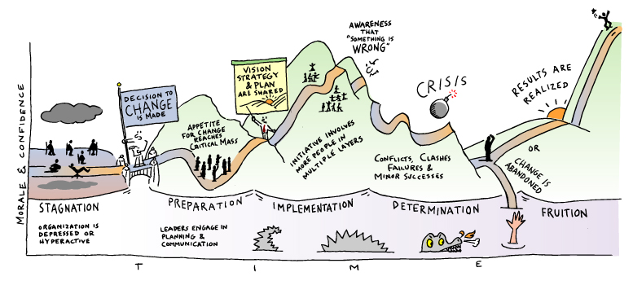
Is the Trustee Ready for a Messy Reality?
Source: Organisation Change Curve Briefing Deck, June 2001, by Jeanie Duck

Slide 10
The Conflict Spiral: Where is the Trustee
Divergence of Interests
Escalation from one stage to the other is “rational”
Does not assume that people are greedy or ill-intentioned
Tragic in the sense that everyone ends up worse off
Avoidable
Hardening of Positions
Communication Breakdown
Alliances
Proxy Wars
Mobilization
All-Out Conflict

Slide 11
A Trustee Protocol: “If It Aint Documented It Didn’t Happen”
A Trustee Protocol manages expectations and imposes order. Its terms may appear in the trust document, an informal agreement with the CFO or the Board, in correspondence with the Grantor and/or the Beneficiaries, or piecemeal in all of these. The one place it will never appear is in “relationships” or oral understandings.
The Protocol is infinitely flexible so long as it makes the Eleven Commandments explicit:
a) To the Beneficiaries
b) To the Board of Directors
c) To the Grantor
d) To Co-Owners
e) To Co-Fiduciaries*
* Protectors, Directed Trusts, Investment Committees and all the creative aspects of modern trust drafting are available…use them but don’t use them to hide!

Slide 12
Cum Grano Salis?
Ten Eleven Commandments for Family Business Interests in Trust

Slide 13
Thou shalt not appear to be in the Grantor’s pocket.
Thou shalt not ignore the Company: Thou arT an owner. Imposing Discipline in Company Affairs is seldom welcome and always needed.
Life events are Company events and may become Trust events.. A valuable Trustee is a bulwark against emotion in the Business.
A fiduciary duty to enforce fiduciary duties is a “thing”. Really, it’s a big thing.
Buy/Sell Agreements, by-laws, and state corporate and LLC statutes are trust documents. Know them and Insist on their Reasonable Enforcement.
Thou shalt be conversant with the Company’s balance sheets, income statements, and financial plans…and be able to explain them to the Beneficiaries.
Thou shalt obsess about phantom income for the trust and its beneficiaries.
Accountings and trustee reporting are your friends. Be narrative, be informative, and be Hard Nosed.
Appreciation is not a given…A Trustee’s Failure to Diversify is seldom mentioned when values soar.
Thou shalt not hope Family conflict will resolve itself if ignored.
Thou shalt know where the exit is.

