Slide 1
IF YOU WRAP YOUR GIFTS CORRECTLY, THEY WILL KEEP ON GIVING
THE ART OF PROPERLY (AND EFFECTIVELY) PASSING AND RECEIVING PROPERTY
Richard A. Oshins
Oshins & Associates, LLC
1645 Village Center Circle, Suite 170
Las Vegas, Nevada 89134
702.341.6000 / 702.341.6001 fax
roshins@oshins.com
www.oshins.com
Naples Estate Planning Council
The Club at Pelican Bay
Naples, FL
January 22, 2015
Copyright 2015 by Richard A. Oshins. All Rights Reserved

Slide 2
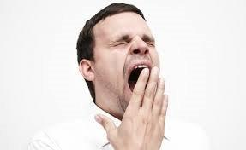
ANOTHER PRESENTATION ON DYNASTY TRUSTS?

Slide 3
Why Are Almost All Trusts
Poorly/Inefficiently/Erroneously Designed?
Take So Long To Draft?
Or, Not Done at All?

Slide 4
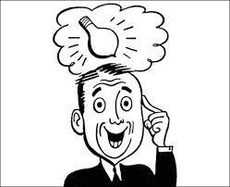
THOUGHT PROVOKING IDEAS
PLANNING OPPORTUNITIES
Many of the discussion contains planning thoughts that should always be considered. Alternatively, reasonable advisors may conclude differently with other proposals and approaches.

Slide 5
PRIMARY DISCUSSION TOPICS
Why Passing Wealth in Trust is Always Best
Structuring Trusts For the Competent Inheritor
Using Trusts to Reduce Income Tax

Slide 6
PRIMARY DISCUSSION TOPICS con’t.
❑ Trust Design Strategies – What is Best?
The “Use” Trust – Simpler Than a Revocable Trust
Most Dynasty Trust Projections are Illusory

Slide 7
WHAT IS ESTATE PLANNING?
❑ Definition: Preserving and Protecting the Family Wealth for the Present and Future Benefit of Their Loved Ones (Including Charities) Consistent with Family Goals and Values
❑ Scope of Presentation – Non-charitable Gifts and Bequests

Slide 8
CLIENT’S PRINCIPAL OBJECTIVES*
Reduce or Eliminate Taxes
Creditor Protection
Pass Wealth the “Right Way”
*Of course, there are other goals such as liquidity.

Slide 9
WHAT IS THE “BEST” WAY TO TRANSFER WEALTH TO YOUR LOVED ONES?*
Outright
In Trust
*Presumptively, clients will want to do what is best for their children, grandchildren and other loved ones. It is our job to make sure that they are making an “informed” decision.

Slide 10
COMMON QUOTES
“All I Want is a Simple Will”
❑ “My Clients Don’t Want the Complexities of Trusts”

Slide 11
REBUTTAL
“Then You Need to Try Harder!”
“Your Clients Will do What You Tell Them to Do!”

Slide 12
WOULD YOU EVER
RECOMMEND A BUSINESS ENTITY THAT COULD BE PIERCED BY CREDITORS OR WOULD BE SUBJECT TO UNNECESSARY INCOME TAXES?

Slide 13
IT HELPS TO EVALUATE THE ESTATE PLANNING PROCESS IN THE CONTEXT OF A BUSINESS DECISION
Business Entity
◊ Creditor Protection
◊ Tax Avoidance
Estate Planning
◊ Creditor Protection
◊ Tax Avoidance

Slide 14
ADVISOR’S ATTITUDES
BUSINESS PLANNING v.
ESTATE PLANNING
In Business Planning - Advisors Never Would Summarily Accept a Client’s Pushback Regarding the Implementation of an Entity
Why Does a Passive Attitude Occur With Regularity
in the Context of Trust Planning?

Slide 15
THE FOUR MAJOR CAUSES OF WEALTH EROSION IN THE U.S.
❑ Mismanagement
❑ Lawsuits
❑ Divorces
❑ Taxes

Slide 16


POTENTIAL RECIPIENTS OF CLIENT’S WEALTH
Family and Friends
Creditors
Divorcing Spouses
Charities
IRS and Other Taxing Authorities

Slide 17
CLIENT’S “WISH LIST”
  1. Control
  2. Use and Enjoyment
  3. Flexible/Amendable
  4. Creditor/Divorce Protection
  5. Save Taxes
  6. Avoid Complexity

Slide 18
THE “WISH LIST” FOR OTHERS GROUPING
Third Party Created Trust - Shelters
◊ Taxes – Transfer and Income (#5)
◊ Creditor Protection (#4)
Controls
◊ Managerial Control (#1)
◊ Use of Trust Property (#2)
◊ Dispositive – “Re-Write” Power (#3)
Avoid Complexity (#6)

Slide 19
FUNDAMENTAL FACT OF ESTATE PLANNING
Trusts Will Shelter Assets From Potential Claimants
Even Though the Beneficiaries Have “Control”

Slide 20
MAGNITUDE OF PROTECTIONS
“The old refrain, “All I want is a simple will,” helps explain why so many people, including many advisors who should know better, so often overlook trusts when planning for the transfer of wealth as an inheritance within the family. In the rush to achieve simplicity, such persons fail to realize the enormous, unnecessary and irretrievable loss of assets (to taxes, divorce, and creditors) that many families will suffer for failing to appreciate the protections that a trust can provide when passing wealth from generation to generation. To quote from an excellent article on the subject, “trusts should be the vehicles of choice for all dispositions to individuals.”
* Ronald D. Aucutt, Structuring Trust Arrangements for Flexibility, 35 U. Miami Inst. Est. Plan., Ch. 9 (2001)

Slide 21
CLIENT / TRANSFEROR’S VIEWPOINT
❑ Desire to do What is “Best” for Children, Grandchildren, etc.
❑ Always Want to Give Protections
❑ Vary Controls
◊ Full Control
◊ Reduced Controls
◊ None at All

Slide 22
FROM RECIPIENT’S VIEWPOINT
Inheriting in Trust is Always Better Than
Inheriting Outright
Provided He/She is Given Adequate
Control

Slide 23
PROFILES OF POTENTIAL INHERITORS
❑ Incapable, Spoiled, Immature
❑ Capable, Mature, Adult
◊ The “Competent Inheritor”
◊ Someone Who You Would Give Wealth to Outright
❑ In Between

Slide 24
TRANFERORS AND BENEFICIARIES
❑ May Not Agree on Slotting
◊ Which Controls Should be Given
◊ When Controls are Given
❑ Both Want
◊ Trust Shelter Benefits

Slide 25
CONCLUSION
❑ For Incapable, Spoiled, Immature
◊ In Trust - Shelter
❑ For Capable, Mature, Adult
◊ In Trust - Shelter
◊ Control
❑ Unless Set Up as an Accommodation

Slide 26
RECYCLE
IRS
TRUST FOR CHILD
OTHER PREDATORS
GRANDCHILD #1
GRANDCHILD #1
GRANDCHILD #1
GRANDCHILD #1
GRANDCHILD #1
GRANDCHILD #1
GRANDCHILD #1
GRANDCHILD #1
GRANDCHILD #1
GRANDCHILD #1
GRANDCHILD #1
GRANDCHILD #1
GRANDCHILD #2
GGC A
GGC B
GGC C
GGC D
GGC E
GGC F
And so on, all Subject to Amendment through a Power of Appointment by the Senior Generations.

Slide 27
PRINCIPAL
“IN TRUST”
BENEFITS

Slide 28
“WISH LIST” – TO BE COVERED IN THE FOLLOWING ORDER
  ❑ Shelters
  ◊ Tax Savings (#5)
  ◊ Creditor / Divorce Protection (#4)
  ❑ Controls
  ◊ Managerial Control (#1)
  ◊ Use and Enjoyment (#2)
  ◊ Flexible and Amendable (#3)
  ❑ Simplicity (#6)

Slide 29

“WISH” LIST #5
TAXES
TRANSFER TAXES
FEDERAL INCOME TAXES
STATE INCOME TAXES

Slide 30
TRANSFER TAXES
“In fact, we haven’t got an estate tax, what we have is, you pay an estate tax if you want to; if you don’t want to, you don’t have to.” – Professor A. James Casner
Estate and Gift Taxes: Hearings Before the House Ways and Means Committee 94th Congress, 2d. Sess., pt. 2, 1335 (March 15-23, 1976)

Slide 31
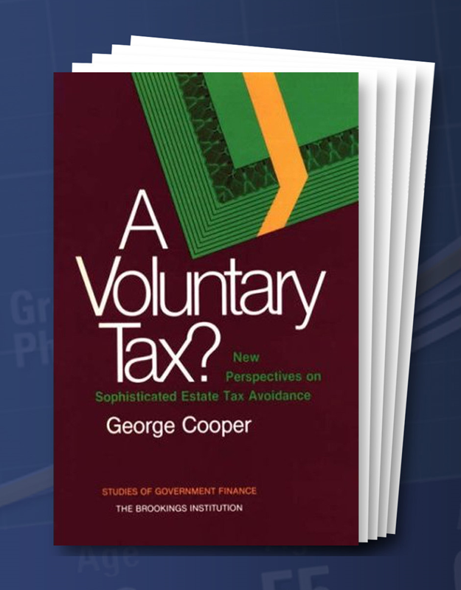
A VOLUNTARY TAX

Slide 32
GRANTOR TRUST STATUS
TAX BURNING PERSONALLY OWNED ASSETS
Estate Depletion as a Result of Grantor
Trust Status
◊ As to Trust Creator - IDGT
◊ Beneficiary Grantor Trust – IRC §678
❑ Freeze, Squeeze and Burn
◊ Most Discussed - Discounting
◊ Most Impactful – Tax Burn

Slide 33
Power of Grantor Trust Status
Year
©2015 Robert S. Keebler, CPA, MST and Stephen J. Bigge, CPA
Keebler & Associates, LLP
All Rights Reserved
33

Slide 34
PLANNING STRATEGY – DISTRIBUTIONS F/B/O
❑ Shifting Favorable Business Opportunity
Discretionary, Dynastic Trust Provides For
Distributions “to or for the benefit of”*
Distribution to a New Trust F/B/O Subject
to Beneficiary’s Power of Withdrawal
◊ Sec 678 Implications
◊ Tax Burn Implications as to Existing Assets
*Our firm’s form expressly provides that trusts f/b/o one or more trust beneficiaries are permissible discretionary distributes.

Slide 35
3.1.1 Discretionary Distributions of Income and/or Principal. The Independent Trustee, in its sole, absolute and unreviewable discretion, shall have the power, the exercise of which shall be absolutely binding on all persons interested now or in the future in this trust, to distribute to or apply for the benefit, enjoyment or use of any one or more of the following permissible distributes:
The primary beneficiary,
The spouse of the primary beneficiary,
The descendants of the primary beneficiary who are then living (even though not now living),
Any then living spouse of any such descendant who is then deceased (provided such spouse was living with such descendant at the time of such descendant’s death or was unable to do so for reasons of health), and/or
Any trust for the primary benefit of any one or more of the above-described permissible distributes (even one created by the Independent Trustee hereunder), whether now existing or hereafter created, except…
so much of the income or principal, or both, of the trust estate, in equal or unequal proportions, and at such time or times as such Independent Trustees shall deem appropriate for such beneficiaries’ benefit, care, comfort, enjoyment or for any other purposes, after taking into consideration their income or other resources…

Slide 36
NEW BUSINESS
❑ Full Control
❑ Transfer Tax Protected
❑ Creditor Protected
❑ Depletes Client’s Other Assets
◊ Estate Tax
◊ Creditors

Slide 37
FEDERAL INCOME TAXES
❑ Efficiency of Trusts for Income Tax Purposes
◊ Conventional Thinking
❑ Bracket Shifting by Sprinkling
◊ Trumps Adverse Compressed Rate Schedule
◊ Not Subject to the “Assignment of Income Doctrine”
◊ Distributions Permissible Up to 65 Days After End of Year

Slide 38
BASIS BUMP PLANNING
Low/Negative Basis Makes Assets Less Valuable
Consider Independent Trustee Giving
Beneficiaries a GPA
◊ Basis Step-up
◊ Protections Maintained
◊ Can Require Consent of Another Person
- IRC §2041(b)(1)(C)(ii)
* Delaware Tax Trap is an Option

Slide 39
REVERSE ESTATE PLANNING
❑ Expand List of Trust Beneficiaries
◊ Parents and Their Descendants
◊ In-laws and Their Descendants
◊ Friends/Employees, etc.
❑ We Use a “Dummy Crummey” Test
◊ Can Vary Distribution Standards

Slide 40
TRUMPS OUTRIGHT
❑ Illustration – Mom and Both In-laws
Multiple Basis Bump Benefits Not
Obtainable With Outright Ownership

Slide 41
STATE INCOME TAXES
Not Given Adequate Respect During the Planning Process
Power of Tax-free Compounding

Slide 42
THE POWER OF COMPOUND GROWTH AND THE SURPRISING IMPACT OF GENERATIONAL ATTRITION
ILLUSORY v. REAL VALUES

Slide 43
COMPOUND GROWTH
“The Most Powerful Force in the Universe is Compound Interest.”
* Quote attributed to Albert Einstein

Slide 44
POWER OF COMPOUND GROWTH
ECONOMICS
❑ Assumptions
◊ $1 Million Contributed to Trust
◊ Trust Lasts 120 Years
◊ 40% Transfer Tax Imposed on
Non-dynastic Trust Assets Every 30 Years

Slide 45
POWER OF COMPOUND GROWTH CHART
$1 Million Example: Dynasty Trust vs. 40% Estate Tax every 30 Years
After-Tax Growth | Value of Dynasty Trust After 120 Years | Value of Property if No Trust
3.00% | $34,710,987 | $4,498,544
4.00% | $110,662,561 | $14,341,868
5.00% | $348,911,561 | $45,218,993
6.00% | $1,088,187,748 | $141,029,132
7.00% | $3,357,788,383 | $435,169,374
8.00% | $10,252,992,943 | $1,328,787,885
9.00% | $30,987,015,749 | $4,015,917,241
10.00% | $92,709,068,818 | $12,015,095,319

Slide 46
$1 Million Example: Dynasty Trust vs.
40% Estate Tax every 30 Years @ 4% Inflation
HOW MUCH IS ENOUGH – WITH INFLATION?
After-Tax Growth | Real Value of Dynasty Trust After 120 Years | Real Value of Property if No Trust
3.00% | $313,665 | $40,651
4.00% | $1,000,000 | $129,600
5.00% | $3,152,932 | $408,620
6.00% | $9,833,386 | $1,274,406
7.00% | $30,342,587 | $3,932,399
8.00% | $92,650,964 | $12,007,564
9.00% | $280,013,543 | $36,289,755
10.00% | $837,763,631 | $108,574,166
S. Oshins, R. Keebler and V. D’Addona; “Choice of Wealth-Shifting Strategies”; NAEPC Annual Convention, Nov. 22, 2013 Page 14

Slide 47
$1 Million Example: Dynasty Trust vs. 40% Estate Tax every 30 Years @ 4% Inflation and with Generational Attrition
HOW MUCH IS ENOUGH – WITH GENERATIONAL ATTRITION?
After-Tax Growth | Real Value of Dynasty Trust After 120 Years | Real Value of Property if No Trust | Inheritors
3.00% | $19,604 | $2,540 | 16
4.00% | $62,500 | $8,100 | 16
5.00% | $197,058 | $25,538 | 16
6.00% | $614,586 | $79,650 | 16
7.00% | $1,896,411 | $245,774 | 16
8.00% | $5,790,685 | $750,472 | 16
9.00% | $17,500,846 | $2,268,109 | 16
10.00% | $52,360,226 | $6,785,885 | 16
S. Oshins, R. Keebler and V. D’Addona; “Choice of Wealth-Shifting Strategies”; NAEPC Annual Convention, Nov. 22, 2013 Page 15

Slide 48
OBSERVATIONS
❑ Charts Only Illustrate Estate Tax Depletion
❑ Ignores Impact of
◊ Divorce
◊ Lawsuits
◊ Reduced Propensity to Spend Trust Assets
◊ State Income Tax Savings
❑ Compound Growth Eliminating all
Depletion Factors is Very Powerful

Slide 49
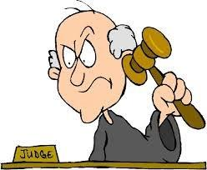
“WISH” LIST #4
CREDITOR AND DIVORCE PROTECTION

Slide 50
CREDITORS/DIVORCE SHELTER
❑ Asset Protection Maxim*
❑ Spendthrift Clause/Situs
❑ Better Than Pre-Nuptial Agreement**
❑ Use Even if Taxes Were Not a
Consideration
*“If You Don’t Own It, It Can’t Be Taken Away From You”, Rothschild and Rubin
810 Tax Management Portfolio, p. A-2
**March 2010 Matrimonial Strategist Newsletter, Trusts and
Divorce, New Techniques, New Issues. Part Two of a Two-Part Article, by Martin M. Shenkman and Richard A. Oshins

Slide 51
PROTECTION FROM CLAIMANTS
“A discretionary trust with “… the distribution discretion held by an independent trustee… is the ultimate in creditor and divorce claims protection – even in a state that restricts so called ‘spendthrift’ trusts – since the beneficiary himself has no enforceable rights against the trust.” (Emphasis supplied)
Frederick R. Keydel
“Trustee Selection, Succession, and Removal: Ways to Blend expertise with Family Control,” 23 U. Miami Inst. On Est. Plan., Ch 4 (1989) at §409.1
Caveat - Under Current Law, I Would Add, “provided that the trust is sitused in a trust friendly jurisdiction”.

Slide 52
DISCRETIONARY TRUSTS EXPOSURE TO DIVORCING SPOUSES IN FLORIDA
Berlinger v. Casselberry, Case No. 2D12-6470
(Fla. 2d DCA Nov. 27, 2013)
Florida Trust Code §736.0503(3) Allows “an order attaching present or future distributions to or for the benefit of the beneficiary.”

Slide 53
DISCRETIONARY TRUSTS EXPOSURE TO DIVORCING SPOUSES IN FLORIDA DESPITE SPENDTHRIFT PROVISION
❑ See*
◊ S. Oshins and Keebler, LISI Asset Protection Planning Newsletter #232 (December 16,2013) at http://leimbergservices.com/collection///SteveLeimberg'sAssetProtectionPlanning%20Newsletter232.pdf?CFID=7208427&CFTOKEN=86767438
◊ Nelson, LISI Asset Protection Planning Newsletter #231 (December 10,2013) at
http://leimbergservices.com/collection///SteveLeimberg'sAssetProtectionPlanning%20Newsletter231.pdf?CFID=7208427&CFTOKEN=86767438
◊ Gopman, Baskies, Ruben and Kaufman, LISI Asset Protection Planning Newsletter #237 (February 13,2014) at http://leimbergservices.com/collection///SteveLeimberg'sAssetProtectionPlanning%20Newsletter237.pdf?CFID=7208427&CFTOKEN=86767438
* Access to LISI Articles Used With the Express Permission of Steve Leimberg

Slide 54
USE EVEN IF TAXES WERE
NOT A CONSIDERATION
“The Economic Growth and Tax Relief Reconciliation Act of 2001 (the Act) will require all practitioners to reexamine traditional estate planning techniques, and in particular, the use of trusts in estate planning. If, in fact, the federal estate and generation-skipping transfer (GST) taxes are repealed, which is admittedly problematical, the focus of estate planning will shift to problems of family wealth preservation and creditor protection. If repeal does not occur, any vehicle used in estate planning should be flexible enough to adjust to that possibility.
A solution is a structure created for the benefit of one’s descendants – which might also include his or her spouse - that can insulate the family wealth from creditors and erode the impact of any transfer taxes on that wealth. This vehicle can then be enjoyed and controlled by the family well into the future and is limited only by the applicable rile against perpetuities Obtaining sufficient nexus to use the laws of a state that does not have a perpetuities restriction can eliminate his restraint.”
Richard A. Oshins and Jerry Kasner
The Dynastic Trust Under the Relief Act of 2001, Tax Notes, October 8, 2001 at 247

Slide 55
TRUST DESIGN PATTERNS
Which Approach Best Satisfies the “Wish” List?

Slide 56
THE THREE BASIC FORMATS
(Each Subject to Variations)
❑ Third-Party Controlled Trust
❑ Traditional Trust
◊ Beneficiary Entitlements
❑ Modern Trust
◊ Fully Discretionary
◊ Beneficiary-Controlled
◊ Irrevocable – But Amendable

Slide 57
THIRD-PARTY CONTROLLED TRUST - INDIVIDUAL
“Serving as an executor or trustee is neither an honor, nor a game for beginners to play. Acting as an executor or trustee required technical skills, experience, and an ability to deal with family members involved. Nevertheless, clients often choose an executor and trustee without fairly evaluating the needs of the estate or trust against the named fiduciary’s abilities to meet those needs.”
Edward Schlesinger, Fifty-Two Questions to Ask Before Choosing Your Executor and Trustee, Successful Estate Planning Ideas and Method Service (1986).

Slide 58
THIRD-PARTY CONTROLLED TRUST - CORPORATE
“Corporate fiduciaries have a definite advantage over nonprofessional individual trustees when considering the myriad account procedures, tax compliance, and tax planning opportunities that must be handled by a trustee. The level of sophistication, expertise and experience that should be applied over the lifetime of any trust is one that few nonprofessionals can provide. This means that most family members will simply be incapable of fully understanding all of the problems that must be avoided and the availability and implications of the tax and property law elections that must be weighed. Even knowledgeable attorneys and accounts do not have the requisite practical day-to-day experience unless they practice solely in this field.
It is possible and in many cases appropriate for a trustee to hire agents for advice and assistance. Most trustees will communicate regularly with outside attorneys and accountants. But planning policy and decisions must be made by the trustee; these are among the duties that cannot be delegated… Will an untrained trustee know whom to call or if the advice received is both legally correct and practical? Will a nonprofessional understand the interplay between tax, trust, and property law well enough to interpret provisions in the trust and adequately inform beneficiaries about tax and other legal effects of various choices?”
S. Leimberg, The Tools and Techniques of Estate Planning 483 (11th ed.1998)

Slide 59
TRADITIONAL TRUST TYPICAL CHARACTERISTICS
❑ Pays Out Income
❑ Principal May Be Invaded
◊ “HEMS”
◊ 5% or $5,000
❑ Distributes Assets at Specified Ages
Anyone Can Be Trustee (Including Beneficiary)

Slide 60
MODERN TRUST
❑ Fully Discretionary
❑ Dynastic
❑ Beneficiary-Controlled (at Proper Time(s))
❑ “Use” Concept
❑ Amendable - Broad SPAs – “Re-Write Powers”

Slide 61
TRADITIONAL TRUST DRAWBACKS
Component Analysis

Slide 62
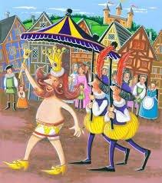
MANY TRUSTS REMIND ME OF
THE EMPEROR’S NEW CLOTHES

Slide 63
PAYS OUT INCOME AT LEAST ANNUALLY
❑ Force-outs Terminate “In-Trust” Shelters ◊ Transfer Tax Inefficient – Leakage
◊ Income Tax Inefficient
◊ Creditor Exposed

Slide 64
FIXING INEFFICIENT TRUSTS
Disregarded Entity Wrapper
◊ No Accounting Income

Slide 65
ASCERTAINABLE STANDARD
“HEMS”*
❑ “Support Trust” Issue**
❑ Relies on Spendthrift Trust Provision
❑ Exception Creditors
◊ Statutorily Created – See Restatement 2nd
◊ Judicially Created – Bacardi v. White, 463 So. 2d 218 (Fla. 1985)
* Some State Statutes Protect HEMS Trusts; Will That Be Respected By Judges In Other Jurisdictions If There Is No Other Contacts With The Governing Law States?
**Steven J. Oshins, Asset Protection Other Than Self-Settled Trusts: Beneficiary Controlled Trusts, FLPs, LLCs, Retirement Plans and Other Creditor Protection Strategies; The 39th Annual Heckerling Institute on Estate Planning, University of Miami School of Law, June 2005.

Slide 66
LAPSING POWER TO WITHDRAW
“5% OR $5,000” ANNUALLY
❑ Estate Tax Exposure
❑ Creditor Protection Adversely Impacted
❑ Income Tax Inefficient PLR 9034004
❑ Administrative Nightmare ◊ Expense
◊ Added Complexities

Slide 67
WHEN TO USE – LAPSING
“5 OR 5” POWERS
To Obtain a Credit for Previously
Taxed Property - IRC § 2013
To Qualify Transfers as Present Interests
To Obtain Beneficiary Grantor Status Under
IRC § 678
◊ See PLR 201039010

Slide 68
DISTRIBUTES ASSETS AT
SPECIFIED AGES –
FORCE-OUT PROVISION
❑ Distributions Terminate “In Trust” Shelters
At What Age(s) Do You Distribute From a
By-Pass Trust?
❑ Multiple “Bite of the Apple” Alternative
◊ Distribution to a BCT

Slide 69
THE ANATOMY OF THE PERFECT TRUST
Component Analysis

Slide 70
THE PERFECT TRUST
Dynastic; Discretionary (with distribution discretion in the hands of an Independent Party who can be fired and replaced); Beneficiary Controlled Trust (unless (i)controls are undesirable or (ii) impermissible under law to avoid the taxing authorities and other claimants); where the use of trust assets rather than distributions are encouraged (unless distributions are beneficial or desirable); sitused in a trust friendly jurisdiction.

Slide 71
DISTRIBUTIONS ARE FULLY DISCRETIONARY
❑ A Fully Discretionary Trust With the Distribution Control in the “Hands” of an Independent Trustee Maximizes Shelter From
◊ Taxes
◊ Claimants
No Entitlements or Force-outs

Slide 72
BENEFICIARY CONTROLLED TRUST (“BCTs”)
“WISH” LIST #1
❑ A Beneficiary Will Not Be Happy Absent Adequate Controls
❑ Primary Beneficiary Will Have “Full Control” of His/Her Trust
❑ “Full Control” is the Maximum Control Permitted Without Exposure to the IRS and Other Potential Claimants

Slide 73
EQUATION TO ACHIEVE MAXIMUM ENJOYMENT
In Trust
◊ Full Control Plus Full Protections
❑ Legal Title
◊ Unimportant
◊ Harmful

Slide 74
KEY CONCEPTS
BENEFICIARY CONTROLS
❑ Managerial Decisions
❑ Identity of Trustees
◊ Removal and Replacement Rights

Slide 75
TYPES OF CONTROLS
❑ Investment (“Wish” List #1)
Identity of the Distribution Trustee
(“Wish” List #1 and #2)
❑ Who Uses Trust-Owned Assets (“Wish” List #2)
❑ Dispositive Control (“Wish” List #3)

Slide 76
CONTROLS MAY BE
Given Immediately
Given at the Proper Time
Reduced/Partial
Increased Over Time
Given as to Some Items But Not Others
Not Given at All if Control is Undesirable

Slide 77
BCT – DUAL TRUSTEE FORMAT - ADMINISTRATIVE/MANAGERIAL CONTROL
Family Trustee
❑ Independent Trustee(s)
◊ Distributions
◊ Situs

Slide 78
INDEPENDENT TRUSTEE
(A/K/A DISTRIBUTION TRUSTEE)
Controls all Tax and Creditor Sensitive
Decisions
Individual or Institution Who Meets the
Criteria of IRC § 672(c) and Rev. Rul. 95-58
“Independence” Does Not Require a
Confrontational Relationship

Slide 79
“USE” TRUST*
“WISH” LIST #2
❑ Key Concept
◊ Keep in Trust Wrapper
◊ Just “Use” Trust Assets
Available to All Beneficiaries
◊ To Primary Beneficiary on a Preferential Basis
* See Richard A. Oshins, Megatrusts™; Representation Without Taxation; NYU 48th Inst. On Federal Taxation, Ch 19 (1990); §19.02

Slide 80
RESULT
❑ Full
◊ Control
◊ Use and Enjoyment
◊ Shelter
❑ “Own nothing, control everything”.*
*Quote attributable to John D. Rockefeller

Slide 81
“USE” TRUST EQUALS SIMPLICITY
“WISH” LIST #6
❑ Similar to a Revocable Trust
❑ Except
◊ No Gratuitous Transfers
◊ Income Tax Return for Non-Grantor Trust

Slide 82
HOW SIMPLE IS THE “USE” TRUST?
❑ Simpler than Outright
◊ Long Term
◊ What is Complex?

Slide 83
DISTRIBUTIONS ARE PERMISSIBLE, BUT DISCOURAGED
❑ Unless there is a Compelling Reason to
Make Them
❑ Separate the Fruit From the Tree
❑ Caveat if Distributions are Needed
◊ Or Wanted
◊ Or Makes Sense

Slide 84
MORE IS NOT ALWAYS BETTER
  ❑ Do These Help?
  ◊ Pay Out Income at Least Annually
  ◊ Ascertainable Standard (“HEMS”)
  ◊ Lapsing “5 or 5” Power
  If They Do Not Improve the Trust Then
  Why Use Them?

Slide 85
FREQUENTLY USED TRUST PROVISIONS
❑ Beneficiary v. Third Party Controlled Trust
◊ Investment Committee
◊ Distribution Committee
❑ Do They Add Anything to a BCT?
❑ Perception (and Reality)
◊ Too Complex
◊ Too Controlling

Slide 86
AMENDABLE/FLEXIBLE –
“RE-WRITE” POWERS
“WISH” LIST #3
  ❑ Special Power of Appointment (“SPA”)
  Deal With Changing Laws, Family
  Dynamics and Needs
  Deal With Dissident Subordinate Beneficiaries

Slide 87
ANCILLARY THOUGHTS

Slide 88
LIFE INSURANCE
❑ Forms the Quintessential ILIT
◊ Primary Beneficiary
◊ Other Beneficiaries
Avoids Gifting Limitations and
Complications
Increases the Value of Life Insurance as
an Asset Class

Slide 89
SEPARATE BRANCHES
GENERALLY PER STIRPITAL
❑ Similar to Outright
❑ Avoids Sibling Conflicts
❑ Can Vary Controls
❑ Different
◊ Trustees
◊ Investments
◊ Advisors
◊ Distributions

Slide 90
“CENTER-PIECE” OF THE FAMILY WEALTH PLAN – IMPACT ON ALTERNATIVE ESTATE PLANNING STRATEGIES
❑ IDGTs
❑ GRATs
❑ FLPs
❑ APTs
❑ QPRTs
❑ Rev Trusts
❑ Pre-Nups

Slide 91
DRAFTING APPROACHES
WHAT IS BETTER?
❑ Customize
❑ “Best Trust”
◊ Modified When Appropriate

Slide 92
CLIENT’S SIX CHILDREN

Slide 93
FACTS
❑ Assume Client Has Six Children
❑ He/She Loves Them Equally

Slide 94
DESIGN AND DRAFTING
❑ Each Child’s Trust Should be
◊ Discretionary
◊ Perpetual
The Extent of the Beneficiary’s Controls
are Varied
◊ Identity of Trustees
◊ Use and Enjoyment
◊ Power of Appointment

Slide 95

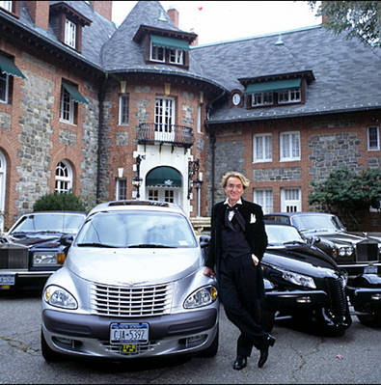



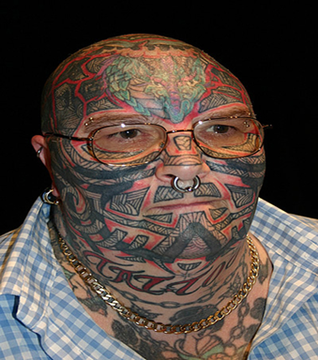

Slide 96
WEALTH RECEIPT PLANNING
❑ Opportunity Shifting
◊ Beneficiary Grantor Trust Status
◊ Tax Burn the Client’s Existing Wealth
❑ General Partner
◊ Control in a Fiduciary Capacity – No Attribution

Slide 97
IN-TRUST PLANNING FROM THE ADVISOR’S PROSPECTIVE
❑ Attorney
❑ CPA
❑ Life Insurance Advisor
❑ Trust Officer
❑ Financial Advisor

Slide 98
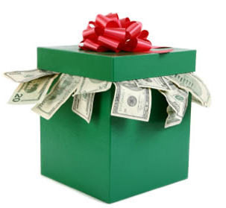

AND, OF COURSE, THE INHERITORS
WHICH WOULD YOUR CLIENT RATHER HAVE?
or

Slide 99
CONCLUSION
❑ “Put not trust in property, rather put your property in trust.”*
◊ Amend Existing Trusts
◊ Decanting – Getting a “Mulligan”
* Oliver Wendel Holmes; The Autocrat of the Breakfast-Table (1858)

Slide 100
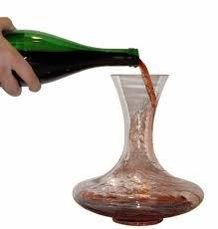
DECANTING
THE “DO-OVER” TRUST

