Slide 1
Estate Planning and Digital Assets: Weren’t we supposed to get a uniform law that fixes everything?
Karin Prangley Brown Brothers Harriman Trust Co. Chicago, IL
Estate Planning Council of Naples September 17, 2015

Slide 2
Agenda
What are digital assets?
Why do we care about them?
Why is it a problem?
How are “They” trying to fix it?
How do we plan for it in the meantime?

Slide 3
What are Digital Assets?
An electronic record.
The term includes:
the catalogue of electronic communications; and
the content of electronic communications.

Slide 4
What are Digital Assets?
Email
Online Sales Accounts (eBay, Amazon, Etsy)
Online Purchasing Accounts (PayPal)
Online Storage / Cloud Storage Accounts (DropBox, Shutterfly, Google Drive)
Webpages
Domain Names
Digital Media Collection (iTunes, Kindle)
Blogs
Social Networking Accounts (Facebook, Twitter, LinkedIn)

Slide 5
Agenda
What are digital assets?
Why do we care about them?
Why is it a problem?
How are “They” trying to fix it?
How do we plan for it in the meantime?

Slide 6
Why do we care about them?
A digital asset can be the key to unlocking other assets (“hard assets”) with financial value.
Digital assets themselves can also have significant financial value.

Slide 7
Financial Value of Digital Assets
Domain Names:
Porn.com sold for $8.8 million in February of 2015.
Vacationrentals.com sold for $35 million in 2007.
Blogging In November of 2011, The Atlantic reported that America’s top 10 most valuable blogs have an estimated aggregate value of $785 million. Gawker.com alone was worth $318 million.

Slide 8
Financial Value of Digital Assets
Twitter Handles:
Naoki Hiroshima had been offered as much as $50,000 for his username @N before it was eventually extorted from him.
Online Businesses:
Former attorney and Ebay seller Linda Lightman, owner of the Ebay shop “Linda’s Stuff” has gross sales of approximately $25 million per year.

Slide 9
Non-financial Value of Digital Assets
Preserving the Decedent’s Story:
Online photo accounts
Personal blogs
Email accounts
Twitter feeds
Genealogical research accounts

Slide 10
Non-financial Value of Digital Assets
Preventing Disclosure of Secrets/Reputation Preservation
Helping a Grieving Family
Protecting Against Identity Theft
AARP estimates 250,000 deceased Americans are victims of identity theft each year.
Protecting the Fiduciary

Slide 11
Agenda
What are digital assets?
Why do we care about them?
Why is it a problem?
How are “They” trying to fix it?
How do we plan for it in the meantime?

Slide 12
Why is it a problem? Obstacles to Access
Don’t know the asset exists;
Don’t have/can’t get username & password;
Passwords may not be sufficient;
Possibly illegal to access the account even with the password.

Slide 13
Did you say “illegal”?
Federal and state laws criminalize certain types of unauthorized access or damage to computers or data.
If the terms of service of the digital asset provider do not allow a fiduciary to access the deceased/disabled user’s account, then access is legally unauthorized.

Slide 14
Unauthorized access is HACKING
The Computer Fraud and Abuse Act (18 USC §1030) criminalizes intentional access of a computer system without authorization or exceeding authorization and thereby obtaining financial data or information from a protected (e.g., private) computer.

Slide 15
What “unauthorized” means
Terms of Service of Digital Asset Providers Prohibit Fiduciary Access
Yahoo! Terms of Service: No Right of Survivorship and Non-Transferability. You agree that your Yahoo! account is non-transferable and any rights to your Yahoo! ID or contents within your account terminate upon your death. Upon receipt of a copy of a death certificate, your account may be terminated and all contents therein permanently deleted.

Slide 16
If TOS say “no,”…
The U.S. Department of Justice has stated that violating a term of service on Facebook or Match.com is a federal crime under the CFAA, however it is not their intention to prosecute such “minor” violations. What constitutes a “non-minor” violation? DOJ prosecuted a mom under the CFAA who posed as a 17–year–old and cyber–bullied her daughter’s classmate, which prohibited MySpace’s terms of service that do not allow false identifying information, including age. U.S. v. Drew, 259 F.R.D. 449 (C.D. Cal. 2009)

Slide 17
Why don’t they just change TOS?
Data privacy laws prohibit providers of electronic communication services from disclosing the contents of a user’s electronic communications with anyone other than the user (not even a legal fiduciary).
Pressures to improve privacy protection for digital assets (in, e.g., employment and family law arenas) can interfere.

Slide 18
Privacy laws dictate TOS
The Stored Wire and Electronic Communications and Transactional Records Access Act
Default rule: Digital asset provider cannot disclose account information, UNLESS AN EXCEPTION APPLIES.
Helpful Exception: if the user provides lawful consent to the disclosure, then the digital asset provider MAY voluntarily disclose account information.

Slide 19
Privacy laws dictate TOS
The Stored Wire and Electronic Communications and Transactional Records Access Act
Negro v. Navalimpianti USA, Inc., 230 Cal. App. 4th 870, 23 (Oct. 21, 2014), which essentially held that consent cannot be imputed, has caused some to believe that you can’t “stand in the shoes” of another for purposes of providing consent.
Of course, there is no exception for fiduciary access upon death or disability (if there was, we wouldn’t be talking about this).

Slide 20
Agenda
What are digital assets?
Why do we care about them?
Why is it a problem?
How are “They” trying to fix it?
How do we plan for it in the meantime?

Slide 21
How are “They” trying to fix it?
State Laws Grant Fiduciary Access
Increasingly, state legislatures are providing express statutory authority to allow Personal Representatives to access and control certain virtual assets of a deceased person.
Eight states (Connecticut, Oklahoma, Idaho, Rhode Island , Indiana, Virginia, Delaware and Nevada) have statutes which give the fiduciary limited access to certain digital assets.
None of these laws expressly supersede conflicting provisions in the terms and conditions and privacy policies of online providers.

Slide 22
A Uniform Law Authorizing Fiduciary Access
In the Spring of 2012, a Uniform Law Commission drafting committee was formed to craft a uniform act, applicable to POAs, Trusts, Wills and Guardianships, that would allow a fiduciary to access digital assets. The draft act was completed in March of 2014 and approved by the ULC and NCCUSL in July of 2014. This act is called the Uniform Fiduciary Access to Digital Assets Act (“UFADAA”).
An earlier draft of UFADAA was enacted in 2014 in Delaware.
UFADAA was introduced in 27 state legislatures this year.

Slide 23
A Uniform Law Authorizing Fiduciary Access
State | Bill | Sponsor | Status
Arkansas | HB 1362 | Shepherd | Introduced
Colorado | HB 1189 | Keyser | Introduced
Connecticut | SB 979 |  | Introduced
Florida | SB102/HB313 | Hukill/Fant | Introduced
Hawaii | HB41/SB467 | Takayama/Keith-Agara | Introduced
Idaho | SB 1055 |  | Introduced
Illinois | SB1376/HB4131 | Hastings/Evans | Introduced
Indiana | SB 368 | Waltz | Introduced
Kentucky | SB 53 | Westerfield | Introduced
Maine | LD 1177 | Hobbins | Introduced
Maryland | HB531/SB429 | Kramer/Klausmeier | Introduced
Massachusetts | HB 3422 | Velis | Introduced
Minnesota | HF 200 | Hilstrom | Introduced
Mississippi | HB 1217 | Lamar | Introduced
Montana | SB 266 | McNally | Introduced
Nebraska | LB 463 | Harr | Introduced
Nevada | AB 434 |  | Introduced
New Mexico | SB 59 | Wirth | Introduced
North Dakota | SB 2106 |  | Introduced
Oregon | SB 369 |  | Introduced
Pennsylvania | SB 518 | Pileggi | Introduced
South Carolina | HB 3444 | McKnight | Introduced
Tennessee | SB 326 | Norris | Introduced
Texas | HB 2183 | Leach | Introduced
Virginia | HB 1477 | Leftwich | Introduced
Washington | SB 5029 | Pedersen | Introduced

Slide 24
A Uniform Law Authorizing Fiduciary Access
UFADAA provides that terms of service of a digital asset provider that restrict fiduciary access are void against strong public policy unless the user, in a manner that is separate and apart from the assent required to open the account (i.e., not merely “click-through”) opts to restrict access (or the user’s estate planning documents restrict access).
Except for an agent acting under a power of attorney and a conservator acting on behalf of a ward, UFADAA compels service providers to disclose the content of communications protected by the Stored Communications Act to a fiduciary and provides that a fiduciary is deemed to have the consent of the account owner.
.

Slide 25
The Providers Strike Back:
Make PEAC, not UFADAA
Although many were involved with drafting UFADAA, representatives from certain large providers of electronic communications services to the public (e.g., Facebook, Yahoo! and Google), their lobbyists and trade associations publicly decried UFADAA, arguing that it:
Violates account owner’s privacy rights;
Violates federal data privacy laws; and
Improperly voids millions of existing contracts with account owners.

Slide 26
The Providers Strike Back:
Make PEAC, not UFADAA
The providers and their lobbyists fought hard to prevent UFADAA from enactment in all 27 states to which it was introduced.
The providers often offered an alternative model legislation, the Privacy Expectations Afterlife Choices Act (“PEAC Act”), which provided an Executor, Personal Representative or Administrator with access to the electronic communications of a deceased account owner only with a court order.

Slide 27
Breaking the Stalemate
In May of 2015, representatives from the ULC and counsel for certain large providers of electronic communications services to the public (e.g., Facebook and Yahoo!) decided to re-group and re-work UFADAA to effectuate a compromise.
That compromise lead to the drafting of the Revised UFADAA (“RUFADAA”).
.

Slide 28
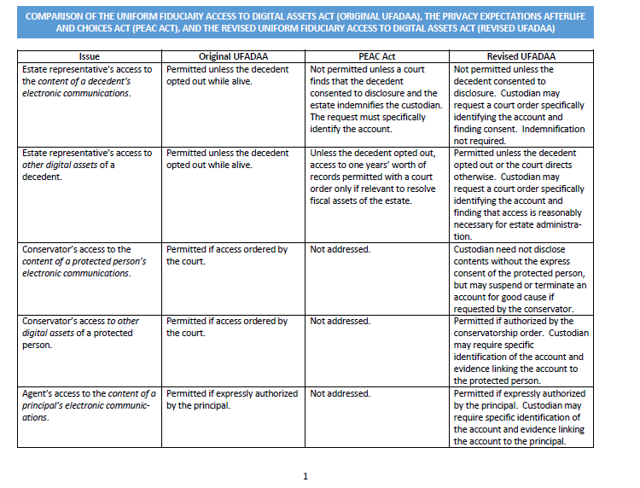
RUFADAA
In May of 2015, representatives from the ULC and counsel for certain large providers of electronic communications services to the public (e.g., Facebook and Yahoo!) decided to re-group and re-work UFADAA to effectuate a compromise.
That compromise lead to the drafting of the Revised UFADAA (“RUFADAA”).
.

Slide 29
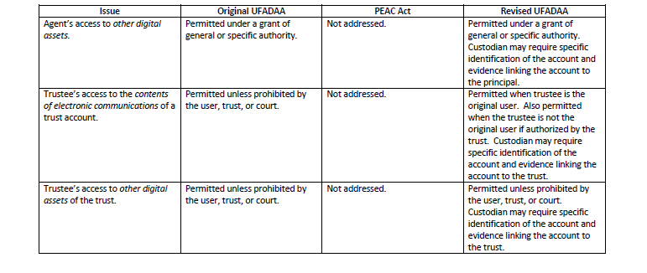
RUFADAA
In May of 2015, representatives from the ULC and counsel for certain large providers of electronic communications services to the public (e.g., Facebook and Yahoo!) decided to re-group and re-work UFADAA to effectuate a compromise.
That compromise lead to the drafting of the Revised UFADAA (“RUFADAA”).
.

Slide 30
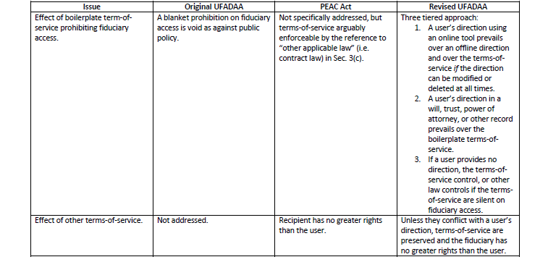
RUFADAA
In May of 2015, representatives from the ULC and counsel for certain large providers of electronic communications services to the public (e.g., Facebook and Yahoo!) decided to re-group and re-work UFADAA to effectuate a compromise.
That compromise lead to the drafting of the Revised UFADAA (“RUFADAA”).
.

Slide 31
Agenda
What are digital assets?
Why do we care about them?
Why is it a problem?
How are “They” trying to fix it?
How do we plan for it in the meantime?

Slide 32
How do we plan for it in the meantime? Digital Assets in the Estate Planning Process
Do you want to preserve digital assets following death or disability?
Many people do not want ALL of their electronic communications available to the fiduciary.

Slide 33
Keep Out!!
If the principal/testator does not want his fiduciary to have access, estate planning documents should expressly state this intent.
Stay abreast of changing times—some TOS may soon allow users to direct that the digital asset should not be made available to a fiduciary.
Use encryption and guess-proof passwords.
Delete frequently.
Consider appointing a special digital assets fiduciary with the task of destroying data. But query whether one should be allowed to “burn the Rembrandt”?

Slide 34
Keep my stuff!
preserve transferability when possible by titling digital assets in the name of an entity;
catalog digital assets, usernames and passwords;
patronize only those digital asset providers that allow fiduciary access; and
add provisions to estate planning documents granting fiduciary access.

Slide 35
Titling Digital Assets to Preserve Usability After Death/Disability
When possible, have LLC or revocable trust own digital assets.
Digital asset providers are increasingly recognizing the importance of digital media/assets to a business. Some do allow digital assets to be owned by an entity.
If principal/testator is a business owner, ensure all digital assets used in connection with the business are owned by the business entity.

Slide 36
Titling Digital Assets to Preserve Usability After Death/Disability
When possible, have LLC or revocable trust own digital assets.
Usually, free web-based email accounts and individual social media profiles cannot be owned by an entity.
Free web-based email accounts are never appropriate for a client’s business activities.
Individual social media accounts are never appropriate for a client’s business activities.

Slide 37
Making a List of Digital Assets for the Fiduciary
Create a list of digital assets stored on password-protected USB drive.
Safeguard the password, and store it separately from the USB drive.

Slide 38
Making a List of Digital Assets for the Fiduciary
Electronic List of Passwords:
To be secure, the electronic file should be encrypted (complex password).
Password protecting a MS Word or other Office document can be easily circumvented.
Use software package designed to store confidential documents and passwords such as KeePass, SecuBox or Web Confidential.
Use online storage such as Estate Assist or Password Box.
Can back-up encrypted list to USB drive.

Slide 39
Making a List of Digital Assets for the Fiduciary
Password to Electronic List of Digital Assets:
Should be kept up-to-date
If estate planning attorney does not have access to the electronic list of digital assets, the attorney can store the password.
As with all client confidential information, password should be stored securely to avoid inadvertent or unauthorized disclosure.

Slide 40
Use Only Those Digital Assets that Allow Fiduciary Access
Google users can designate up to 10 individuals to receive the contents of their accounts in the event that such accounts are inactive for a designated period selected by the user.
Google offers cloud storage, blog hosting, an e-book and digital music library, photo and video storage/sharing and social media.

Slide 41
Add Provisions to Estate Planning Documents Granting Fiduciary Access
CRUCIAL under RUFADAA.
Our clients need to provide express consent to disclosure of their electronic communications to their fiduciaries to gain full access to their digital assets.
Consent can be provided in the estate planning documents or in an online tool (i.e., account setting) offered by the account provider that is not “click-through.”

Slide 42
Estate Planning and Digital Assets: Weren’t we supposed to get a uniform law that fixes everything?
Karin Prangley Brown Brothers Harriman Trust Co. Chicago, IL
Estate Planning Council of Naples September 17, 2015

